Slide 1

Northwest Vista College
Ignite an Institutional Revival by Improving
Math Outcomes
Forum Session
League of Innovations, Chicago 2016
Dr. Ric Baser, Anna Harwin and Mary Zocchi
Project Math Paths, a DOE Title V grant to increase enrollment, graduation and STEM completion

Slide 2
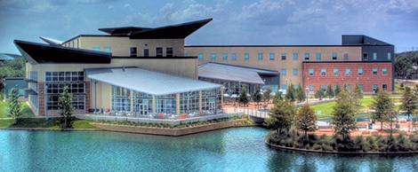
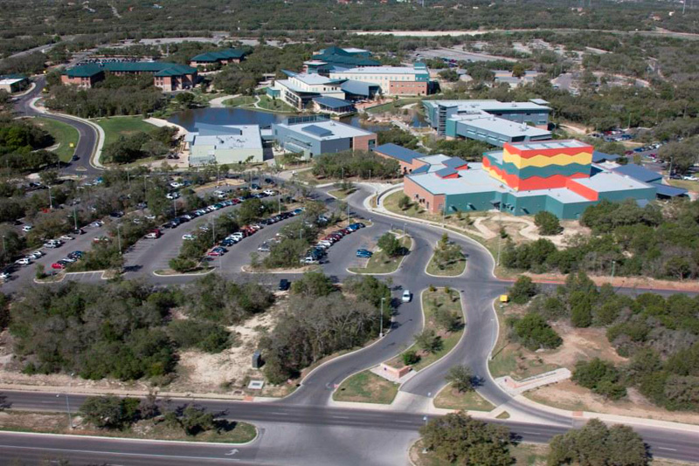
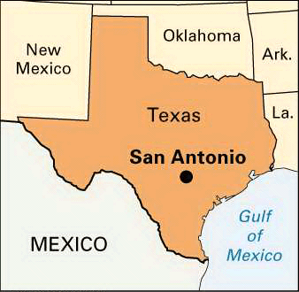
Northwest Vista College – San Antonio
One of the 5 independently accredited Alamo District Colleges – founded in 1995

Slide 3
Student Profile Fall 2015
25% (4237) Full-Time,
75% (12419) Part-Time
54% (9066) Female,
46% (7590) Male
Ethnicity
  62% (10326) Hispanic
  7% (1179) African-American
  25% (4105) White
  6% (1046) Other
19% (3150) Dual Credit
47% (1216) FTIC Require Remediation*
54% Receive Financial Aid* 6990/(15797-2810)
45% Economically Disadvantaged* 5853/(15797-2810)

Slide 4
Fall Headcount Enrollment

Slide 5
Course Completion Rates

Slide 6
Degrees and Certificates Awarded

Slide 7
Completion Agenda
Paradigm Shift: Access to Completion
AACC Pathways
Achieving the Dream
Case-loaded Advisement Model
Institutes
SACS-COC Accreditation
State Funding
2.3 Million Dollar Title V Grant

Slide 8
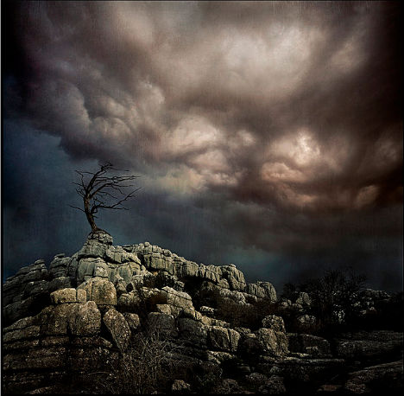

Math $≠$College Algebra
More than two-thirds of our students gave up their academic lives to this misconception
They never became
math core complete,
thus NOT able to attain their academic goals
Notes:
A world in which esoteric knowledge of factoring and roots meant access to a degree

Slide 9
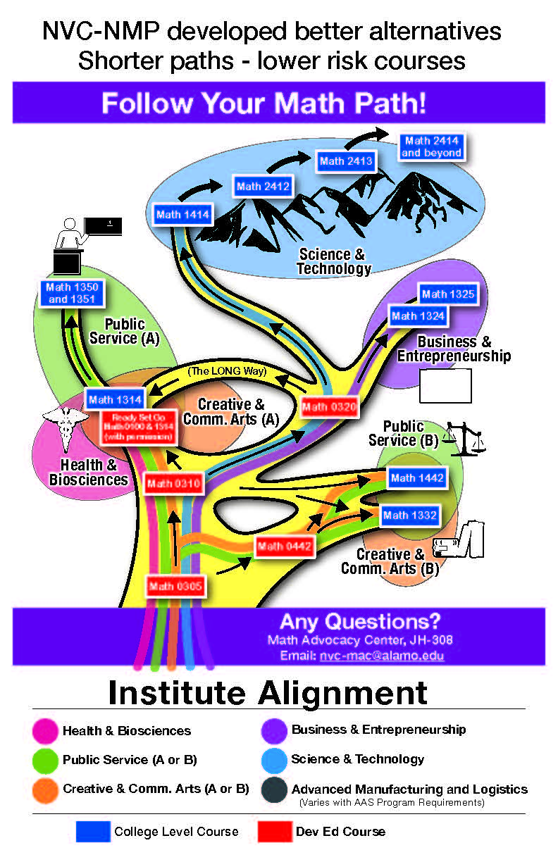
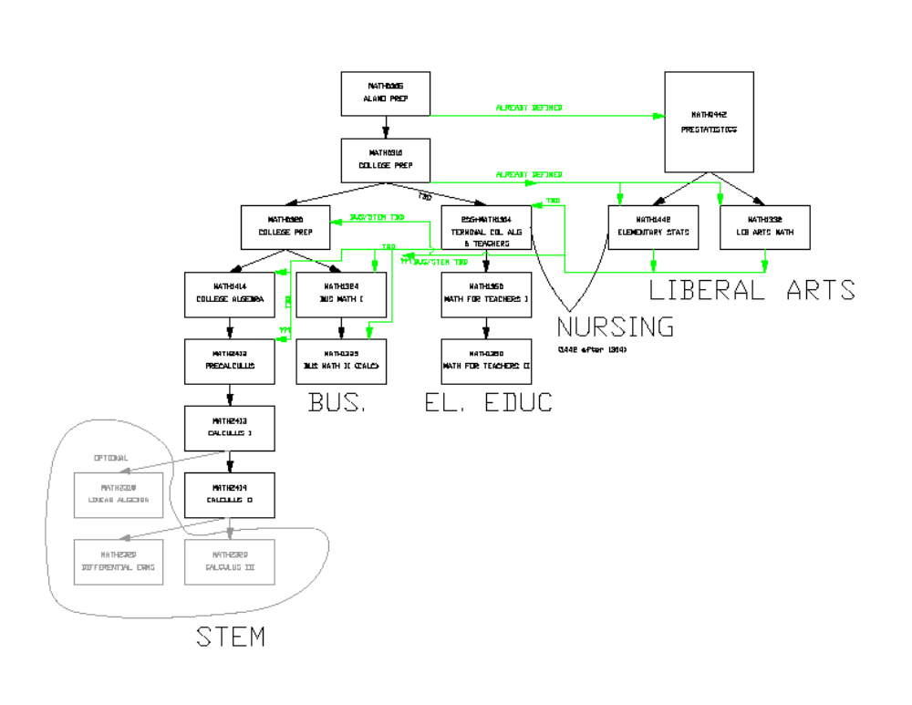
AND SO….NVC-NMP developed better…
Options
Shortcuts
Accelerations
Shorter Paths –
Lower Risk Courses

Slide 10

And therefore the problem would be solved ….
IF WE COULD GET OUR STUDENTS IN THEIR BEST PATHWAY

Slide 11
And so the vision was born
… Math Faculty enter with data, doom, despair and a plan
What if we worked across the college?
…across all of its silos?
…to populate those branches, those math paths…
AND bring in brilliant cross college leadership?

Slide 12

Leadership
  Sharing the importance of math placement as a college wide priority
  Hiring a coordinator to facilitate math optimization (Secret Sauce)

Slide 13
Secret Sauce Ingredients
    Gaining buy-in across the campus
    1:1 advising (SMAT)
    Breaking down the silo walls (math is everybody’s problem)

Slide 14
Student Success Connections
Lurking Pre-req’s
Title V Project Math Paths
SMAT Development
Math Faculty Training PD Spr 15
Continuing students
What had to take place to get the paths populated?
Bragging Breakfast
FTIC NSO advising STEM
High Risk Math – Best Practices
Baser Updates
La ReVIsta
Mini Vista Central
Testing Center
SMAT Training Faculty and Tutors
Transfer students
SMAT 320 & 1414
Enrollment Drop/Add
FTIC NSO training
320-1414 alignment
Refresher training on TOM advising
TOM
DM Inventory
Logic Model
Conference Presentation NADE
SMAT Data
Employee Development Day
FITWProposal
VETS
SMAT Implementation new & continuing students
AHSIE
Sally First Business Shell
New Faculty Training TOM
EXEMPT students SMAT 320 & 1414
SDEV PD on TOM
League of Innovations

Slide 15
SMAT: Strategic Math Attack Team
Invasive (intrusive) 1:1 Advising
DM
DM
305 and 310
Student Inventory
320 - major? Math background
CL STEM Algebra, Math Packet assigned a week before classes start
Math Packet due by 2nd day of class.
SMAT member advises 1:1
Incoming STEM Student
Math Placement based on Test Scores
SMAT Process: First Week of Classes
If NOT STEM, move to non STEM math path
Could not complete packet satisfactorily. Advised to move to DM or alternate CL math course
Advised to Move BEFORE Census
SMAT process Before last day to withdraw or to register for next semester
SMAT member advises 1:1
SMAT member advises 1:1
ALL Developmental Math Students are Advised 1:1 at least once during EACH DM course that they take.

Slide 16

Cross college connections have been made
SDEV (Freshman Experience Class)
Math Faculty
Enrollment/Financial Aid Services
Vista Central
Title V funding
to increase enrollment, graduation and STEM completion
Faculty Advising
Student Success Advisors
Veterans/Active Duty Office
Math Refresher
MATH Advocacy Center
NSO/FTIC
(New Student Orientation/First Time in College)

Slide 17

We know this will work because
First Fall term, 600 students were redistributed from high-risk long paths to low-risk shorter paths
And so what happened?
338 more Students
were successful
And 222 more students are now core math complete

Slide 18
What does it take to REALLY activate math path changes?
Results that show alternatives paths will yield better outcomes
Faculty leadership and ownership to facilitate the design of paths
A way to ensure that alternative math paths produce transferable core courses (NMP)
Determination that these paths serve the student population’s academic needs (Institutes)
IF success is a college wide goal, THEN everyone must understand that math is the priority!

Slide 19
What this means in terms of enrollment, graduation numbers and graduation rates…
Our LOWEST Developmental Math Students will become math core complete within three terms
STEM math courses can be made sufficiently rigorous to support STEM degrees
Pre-service teachers will be better prepared to teach math (math pipeline)
Enrollment will grow as failure rates shrink (plug the leaking math bucket)
The number of At-Risk math courses will diminish as Success Increases
Three year graduation rates will double by 2018
Math will cease to be the most intractable obstacle to college completion

Slide 20
Redistribution of Students from STEM College Algebra to Statistics

Slide 21
Better Terminal College Algebra Outcomes using Math RSG
Increased success and acceleration toward College Algebra for Teachers and Nursing students

Slide 22
What we expect…..
Core Math Completion Growth …..
More students are eligible

Slide 23
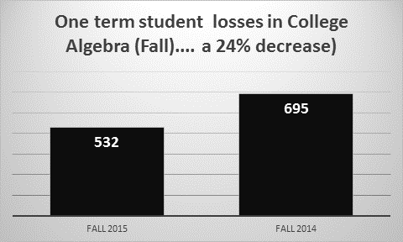

Slide 24
Number of High Risk Courses

Slide 25
Four-Year FTIC Graduation Rates

Slide 26

Thus giving real access and support to our underserved students and their communities
Revival
Students First: Faculty Initiative
Collaboration: Math Course Sequence
Respect for All: Cross Campus Support
Community Engaged: Faces on Everyone
Can-Do Spirit: New Grant, Vista Central
Data-Informed: New Advising Model
Project Math Paths
Ric Baser
Anna Harwin
Mary Zocchi
Northwest Vista College

