Slide 1

Improving Presentations the Zen Way
Dallas Dolan, Community College of Baltimore County
Notes:
Handout.
Introductions: Who I am and what I do. Background in Psychology and faculty development.
Disclaimer: If you came to meditate or do Yoga, you may be disappointed. Zen is really a metaphor for thinking about improving our presentations.
Where are you from and what were you hoping to gain today?
When you see Zen, what do you think of?

Slide 2

“ I suppose it is tempting, if the only tool you have is a hammer, to treat everything as if it were a nail.”
~Abraham Maslow
Notes:
Abraham Maslow was a psychologist who is best known for his “Hierarchy of Needs”.
What might this quote have to do with improving our presentations? How many of you use PowerPoint? Prezi? Others? These are common presentation platforms that have become ubiquitous in education, marketing and almost all other fields. I’ve been thinking about how powerpoint and other platforms shape our presentations in classrooms, conferences like this one, and even shape our thinking.

Slide 3



Notes:
Made to Stick, Visible Learning and the Science of How We Learn, and Presentation Zen by Garr Reynolds. He’s also written a number of articles and blogs on this topic. You have a resource list on your handout. I’m drawing from cognitive psychology, marketing, and engineering, as well as from Eastern philosophies such as Buddhism.

Slide 4
PowerPoint Culture
Notes:
Some of the worst of PowerPoint mistakes. See how many you have seen in other people’s PP presentations. https://www.youtube.com/watch?v=lpvgfmEU2Ck

Slide 5

Notes:
What do you notice about this set-up?

Slide 6
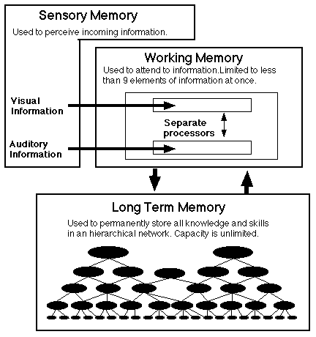
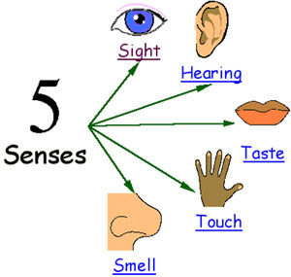
Information Processing
Notes:
Sensory memory lasts only as long as the neurons that deliver the sense are activated (seconds at most). Information must pass into working memory (be attended to) if it has any chance of being ‘remembered’ for longer than a few seconds. Our task is to make the stimulus have enough of an impression to be ‘noticed’ and moved to working memory. Working Memory is also called ‘short term memory’ Once there, a limited amount of information (7-9 items or chunks) can be held for a limited amount of time (a few seconds) before being processed into long term memory. There are separate processing centers in short term memory for visual and auditory information. Long term memory is more-or-less permanent, and capacity is unknown. What you are seeing here in LTM is the schema---mental structures where information is linked with other ‘prior knowledge’ to store the information in a way that the brain can retrieve it.

Slide 7
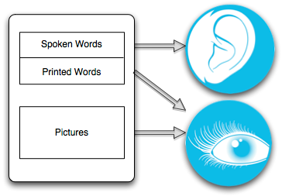
Cognitive Load in the classroom
Notes:
In education, we are concerned mostly about the auditory and visual channels (although it is clear that learning goes on through the other sensory channels. Spoken words are processed in the auditory area of the brain, both printed words and other visuals are processed in the visual cortex. These are separate processing channels. One thing we know about cognitive load, is we want to decrease extraneous material so that we do not overload the channels.

Slide 8

Effective Use of Multimedia
Notes:
Do we know that using multi-media (such as PowerPoint or Prezi) helps at all? Does it enhance learning?
It turns out it can, but it can also overload the sensory memory and make it less likely information will get to long term memory.
Narration with pictures (visual) is better than narration alone. Multimedia Effect
People learn better when words are presented as narration rather than text. Modality Principal:
People learn better from narration and graphics rather than narration, graphics and text. Redundancy Principle:
People learn better when extraneous visual material is excluded. Coherence Principle:

Slide 9

Multimedia Effect: narration with pictures
Notes:
Multimedia Effect: Narration with pictures (visual) is better than narration alone

Slide 10
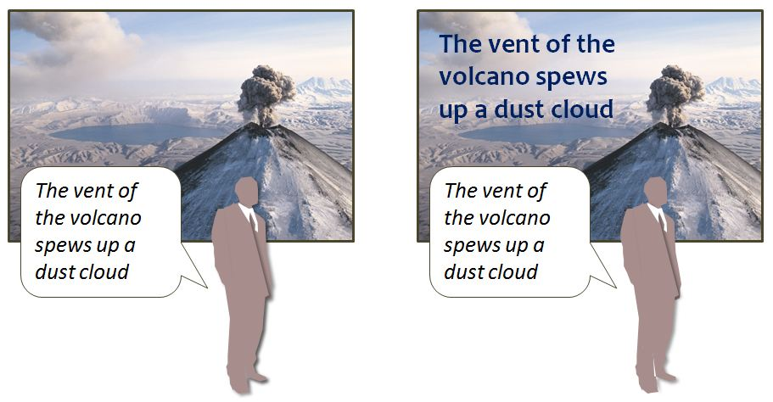
.
Modality Principle
Notes:
Which is better?
Modality principle: People learn better when words are presented as narration rather than text

Slide 11
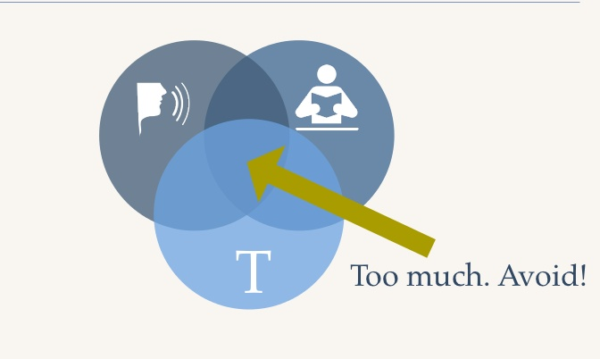
Narration
Text
Graphics
Redundancy Principle
Notes:
Redundancy Principle: People learn better from narration and graphics rather than narration, graphics and text

Slide 12
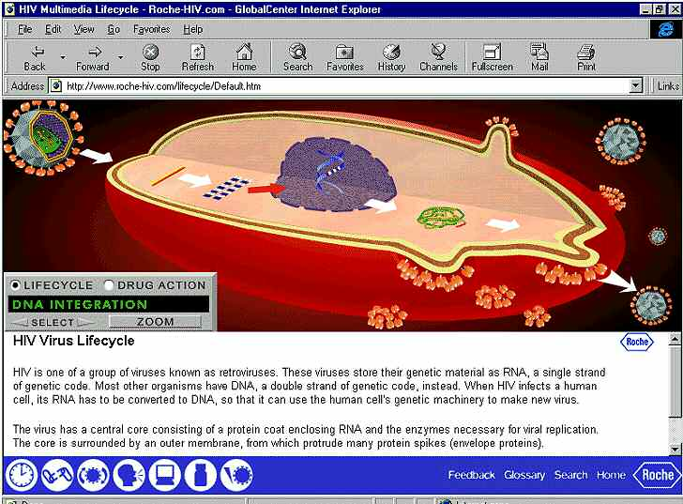
Coherence Principle
Notes:
Coherence Principle: People learn better when extraneous visual material is excluded!
Those are some of the critical principles from what we know about cognitive processing. Now let’s turn to Eastern Philosophy and see what we can learn from that about presentations.

Slide 13

Japanese Influences
Beginner’s Mind
Be in the moment
Moderation
Minimization
Notes:
Garr Reynolds has studied and published about how borrowing from the tenants of Zen can improve presentations. He talks about several principles: (Next slides)
Start with the beginner’s mind: Don’t be afraid to make mistakes, take a fresh approach.
Being in the moment: Energy, creativity, connect with audience
Moderation in all things, especially words on slides
Minimization of chaos and clutter
Here are three more Japanese principles to apply to improve our presentations.

Slide 14

Kanso = Simplicity
Notes:
Three Zen inspired themes to remember in presentations.
Simplicity in design. Keep slides simple: Too much slide information overloads people’s cognitive systems. Taking in words (reading) (hearing) plus images is too much. The slides are not to be the ‘star of the show’, you are!

Slide 15

Shibumi = Elegance
Notes:
Elegance: Slides should help people organize and integrate information. Can your visuals be understood in 3 seconds? If not, redesign them to support your talk.

Slide 16

Shizen = Naturalness
Notes:
Be natural in your delivery. Reading from slides interferes with the connection between you and your students/audience.

Slide 17
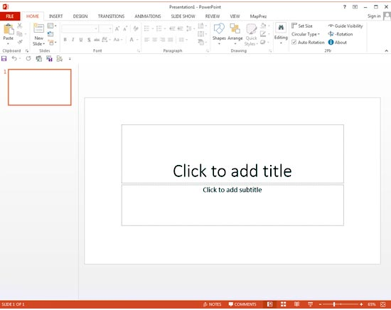
Do Not Create In PowerPoint
Notes:
Also, avoid creating your presentation in PowerPoint/Prezi first. Reynolds recommends going analog=paper and pencil, post it notes, etc. in the creative process. Also, avoid using animation too much, and use it for impact.

Slide 18
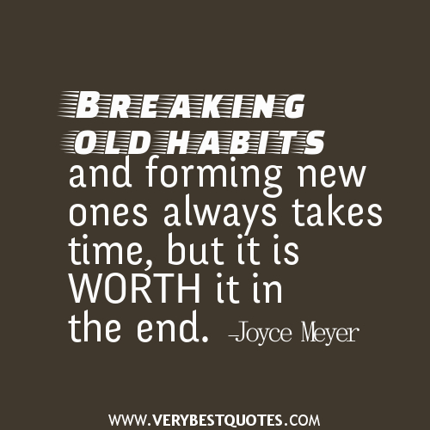

Slide 19
Eating Disorders
DANGER: LOOKING AT OLD PRESENTATIONS MAY CAUSE DISTRESS
Diagnosis via DSM-IV

Slide 20
Anorexia Nervosa
Patient does not maintain a minimum body weight (85% of expected weight for height and age)
Despite being underweight, intense fears of weight gain or obesity
Abnormal perception of body
  `Emphasis on weight or shape
  Denies seriousness of low weight
  Distorted body image
Missed at least 3 consecutive menstrual periods

Slide 21
Specifiers for Anorexia
Binge/Purge Type:
  During the current episode the patient purges or eats in binges
Restricting Type:
  During the current episode the patient has not binged/purged, but rather has seriously restricted caloric intake.

Slide 22
Bulimia Nervosa
Recurrent episodes of binge eating
  Eating an amount of food definitely larger than most people would eat in a defined period of time
  A sense of loss of control over eating binge once it begins
Recurrent compensatory behaviors to prevent weight gain
  Self-induced vomiting, misuse of laxatives, diuretics, etc.
The binges occur on average, twice a week over at least a 3 month period of time
Self-evaluation is unduly influenced by shape and weight
Not during episodes of Anorexia

Slide 23
Specifiers For Bulimia Nervosa
Purging Type
  During the current episode, the person has regularly engaged in self-induced vomiting or misuse of laxatives, diuretics or enemas
Non-purging Type
  During the current episode, the person has used other inappropriate compensatory behaviors such as fasting or excessive exercise (but has not engaged in purging)

Slide 24
Eating Disorder NOS
Used when one criteria is not met, but others are, for example
  Meets all criteria for Anorexia except still has regular menses
  Meets all criteria except current weight is in “normal” range

Slide 25
Some interesting statistics
Majority of people with anorexia-bulimia are women
Risk is much higher in women born since 1960—why?
Cross culturally, what would explain Nasser’s study showing 0% eating disorders in Cairo, Egypt, but 12% of Egyptian women in college in England had eating disorders?
Anorexia and bulimia are strongly developmentally related.

Slide 26
Causes of Eating Disorders
Very heavily culturally influenced
Predominance of dieting and diet related information in media
Possible role of family relationships, pressure to be ‘perfect’

Slide 27
Integrative Model of Eating Disorders
Psychological Influences: Anxiety about appearance and presentation to others
Biological influences: Inherited vulnerability to stress, associated with impulsive eating.
Social influences: Cultural pressure to be thin, family pressure

Slide 28
Treatment of Eating Disorders
Drug Treatments
  SSRI’s to decrease anxiety and modify eating behavior (seems to reduce compulsions)
Psychological Treatments
  Cognitive-behavioral treatment (CBT)
    Good eating habits
    Correct cognitions about eating/diet/weight gain
    Stop purging (which reduces binging)
  Interpersonal psychotherapy
    Effective, but not as quickly as CBT

Slide 29
DSM-IV Video Series
Susan: Anorexia Nervosa

Slide 30
I really gave that lecture!
Did you see any problems? Anything that could be improved?
Stay tuned for the new version……..
Notes:
Critique this PP presentation!

Slide 31

Eating Disorders

Slide 32
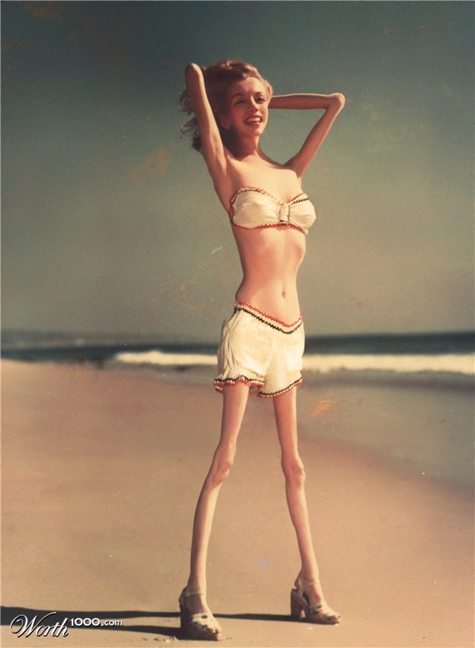
Anorexia Nervosa
Notes:
Images should be compelling, and help to cement the idea you are trying to get across into their long-term memories. Does this image capture your attention? Does it help to tell a story? Notice it takes up most of the slide.
Patient does not maintain a minimum body weight (85% of expected weight for height and age)
Despite being underweight, intense fears of weight gain or obesity
Abnormal perception of body
`Emphasis on weight or shape
Denies seriousness of low weight
Distorted body image
Missed at least 3 consecutive menstrual periods

Slide 33
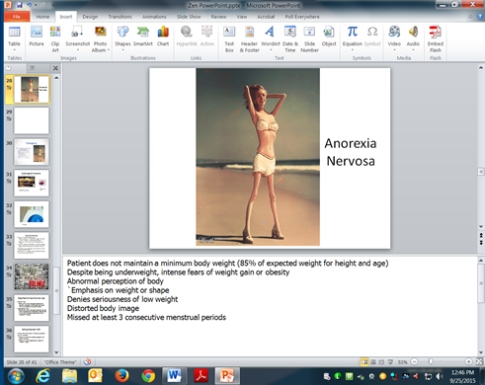
Notes:
Here’s an example of what I am seeing while the students are seeing that picture. Now with the picture for them to really look at, I can give them the criteria, ask what they notice, or flip the classroom by asking them to come to class with the criteria and discuss them.

Slide 34

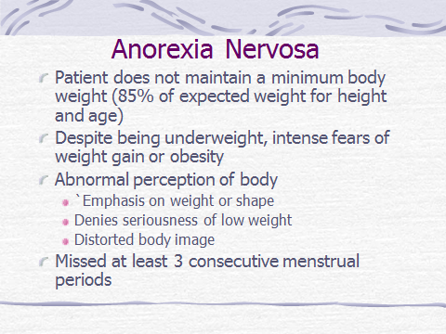
Compare
Notes:
What do you notice when you compare these two slides?

Slide 35


Subtypes of Anorexia
Restricting type
Binge-Purge Type
Notes:
Binge/Purge Type:
During the current episode the patient purges or eats in binges
Restricting Type:
During the current episode the patient has not binged/purged, but rather has seriously restricted caloric intake.

Slide 36

Purging
Notes:
So with this image I talk about purging….most people with anorexia learn how to vomit at will, after sticking their fingers down their throats many times. Purging can also involve the use of laxatives….so you get the symbolism.

Slide 37
Bulimia Nervosa
Recurrent episodes of binge eating
  Eating an amount of food definitely larger than most people would eat in a defined period of time
  A sense of loss of control over eating binge once it begins
Recurrent compensatory behaviors to prevent weight gain
  Self-induced vomiting, misuse of laxatives, diuretics, etc.
The binges occur on average, twice a week over at least a 3 month period of time
Self-evaluation is unduly influenced by shape and weight
Not during episodes of Anorexia
Notes:
Before slide …..instead of this

Slide 38

Bulimia Nervosa
Notes:
After slide. This is a Wordle about bulimia.
Recurrent episodes of binge eating
Eating an amount of food definitely larger than most people would eat in a defined period of time
A sense of loss of control over eating binge once it begins
Recurrent compensatory behaviors to prevent weight gain
Self-induced vomiting, misuse of laxatives, diuretics, etc.
The binges occur on average, twice a week over at least a 3 month period of time
Self-evaluation is unduly influenced by shape and weight
Not during episodes of Anorexia

Slide 39
Specifiers For Bulimia Nervosa
Purging Type
  During the current episode, the person has regularly engaged in self-induced vomiting or misuse of laxatives, diuretics or enemas
Non-purging Type
  During the current episode, the person has used other inappropriate compensatory behaviors such as fasting or excessive exercise (but has not engaged in purging)
Notes:
Analyze this slide and tell me all the ways I could improve it.

Slide 40

Notes:
5 minutes: Guided practice time. Work together if someone near you has a PP slide to work on.
If you have one with you, please pull up your own PP or Prezi to work on. Choose just one slide to work on. Save the “old” and the “new”.

Slide 41
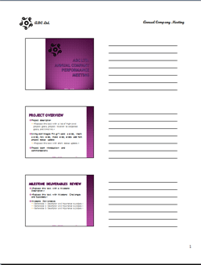
What about the handout?
Notes:
Give students information they need to remember, organized in a way they can best remember it. The one page handout I’ve prepared for you is an example. It helps “students” know what is important, what information they should focus on, and guides them in their note-taking.

Slide 42
…….Dakara nani
So what?
What now?
Notes:
Japanese expression. What will you do with this information? What are three things you want to remember and take back with you? How can you use this information immediately?

Slide 43

May your journey be a good one!
Notes:
Caution: You cannot change every presentation you have for a course at once! But, you can improve one presentation at a time.

Slide 44
Thanks for coming!

Slide 45
20 Minute Mentor: Improving PowerPoint

Slide 46
Proposal using PowerPoint
Notes:
https://www.youtube.com/watch?v=WGiePuNFXwY

