Slide 1
Integrating an Online Writing Lab into Curricula
www.excelsior.edu
Presented By:
Kimberly Lourinia, Assistant Director of Academic Partnerships
Lisa LaVigna, Executive Director of Outreach and Access
Notes:
KIM:
Welcome.
KIM/LISA:
Introductions.

Slide 2

Agenda
What is an OWL?
Effectiveness
Importance of OER’s
Excelsior College OWL
Purdue University OWL
Benefits
Examples
Implementation
Notes:
KIM:

Slide 3

Poll
Who is currently using an online writing lab in their courses?
Notes:
LISA:

Slide 4








OWL
Online Writing Lab
Open Resources
Accessibility
Improve Writing
Available OWL’s
  Excelsior College
  Purdue University
Notes:
KIM:
OWLs are writing tools designed to engage college students in improving their writing skills to fit what college professor’s are looking for in essays and reports. They focus on improving writing in general, an important skills to have in all careers, regardless of the exact field of study in college.
Different colleges such as Colorado State, Texas Southern University, UNC and Butler Community College among others have their own OWLs. Excelsior College and Purdue University offer their own versions of online OWLs at no cost to users and as these two are probably the best known we will use them as examples today. As OWLs are an online based technology, they can be accessed 24/7 from any laptop, tablet or other device from any place with an internet connection.
Because writing is an important skill which will follow students for the rest of their lives, OWLs are a great resource for students as they contain a wealth of knowledge and interactive media for improving writing skills and style. OWLs will begin to improve the quality of education as more students can utilize technology towards improving their education.

Slide 5

Benefits of an OWL
Saves Money
Engages Students and Faculty
Adapts to Faculty Needs
Improves Quality of Education
Improves Student Success
Extends The Services of The College/University
Creates Flexibility in Coursework
Increases Workforce Skills
Notes:
KIM:

Slide 6
Poll
Who can explain OER’s?
Can anyone give us an example?
Notes:
LISA:

Slide 7

Importance of OER’s
Online Education Resources
Freely Accessible
Licensed Content
Provide Cost Savings
Engages Faculty With Content
Adapts Course Materials to Course Objectives
Measure the Results
Notes:
LISA:
According to a College Board report, buying textbooks and supplies can cost students between $1,200 and $1,300 each year, which can be up to 40% of the cost of tuition at community colleges. A 2014 study by the Student Public Interest Research Group (PIRGs) found, if just one traditional textbook for all full-time undergraduates in the U.S. was replaced with an open textbook each year, students would save more than $1.4 billion nationally (Source: Community College Journal 2015). WOW…now that is a lot of money.
With 65% of students going to great lengths to avoid paying full price for books and some choosing not to buy textbooks at all, it is important that we as institutions of higher education create solutions so this group of students doesn’t fall behind in class (Source: Community College Journal 2015). 27% of first year students say they did not purchase academic materials due to cost (Source: National Survey on Student Engagement 2012).
With awareness of OER’s growing, there is still room for growth. About two thirds of faculty from two and four year institutions admitted they were not very aware of OER’s but once they understood the concept, about 90% said they would be very interested in using them.
Here are a couple of examples of what some schools are doing:
(1) Tidewater Community College in Virginia piloted the Z-Degree, a zero-textbook cost degree program. Students can complete an associate degree in business using OER’s rather than traditional textbooks. Students in the program saved $2,400 in textbook costs. The Virginia Community College System may make the Z-Degree program system-wide with a $200,000 grant from the Hewlett Foundation that would apply to 15 Virginia community colleges. This is expected to save some 50,000 students more than $5 million in its first year.
(2) Tacoma Community College in Washington, the college launched an OER pilot project in 2012 that introduced OER’s in more than 65 course sections. The project has reached more than 10,000 students and generated more than $1.1 million dollars in student savings.
While all of this sounds great, it is going to be important for the impact of OER’s to be measured consistently to ensure that student learning does not decrease.

Slide 8

Excelsior College OWL
www.owl.excelsior.edu
Grant Funded
Free Resource
Accessibility
Awards & Recognition
  2015 Award for Outstanding New Technology and/or Delivery System
    Instructional Technology Council (ITC)
  2014 Outstanding Work (WOW) Award
    WICHE Cooperative for Educational Technologies (WCET)
  2014 Distance Education Innovation Award
    National University Technology Network (NUTN)
Notes:
LISA:
Funded by The Kresge Foundation, the OWL is a highly interactive, media-rich website designed to help freshmen or adult learners returning to school make the transition to college-level writing.
As a FREE resource, the Excelsior College OWL provides comprehensive support for all writers in eight major areas of writing and one gaming area. The OWL was built to guide users through the core components of college-level writing, to learn new skills or polish old ones, in a fun, supportive and engaging environment. It is a great tool for students and others looking for advice on how to improve their writing skills.
Through its development which includes responsive design technology the OWL provides easy accessibility on any device.
Since its launch, the Excelsior College OWL has received various awards and recognitions which include:
2015 Award for Outstanding New Technology and/or Delivery System
2014 Outstanding Work (WOW) Award
2014 Distance Education Innovation Award
In November of 2014, Excelsior College announced an additional one-year Higher Education Services Corporation (HESC) grant to integrate an expanded, open-access OWL into introductory English courses at Excelsior and New York State community colleges. Queensborough Community College and Onondaga Community College are (2) New York State community colleges that will partner with Excelsior on this expansion.

Slide 9
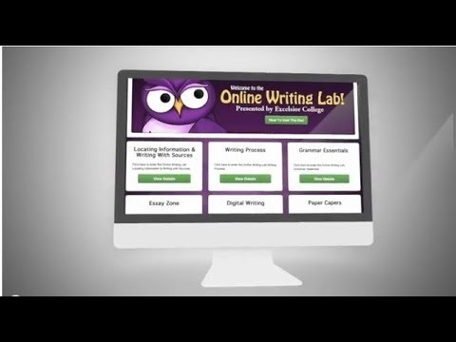
Excelsior College OWL
Notes:
LISA:
Here is a one-minute trailer showing what the Excelsior College OWL is.

Slide 10
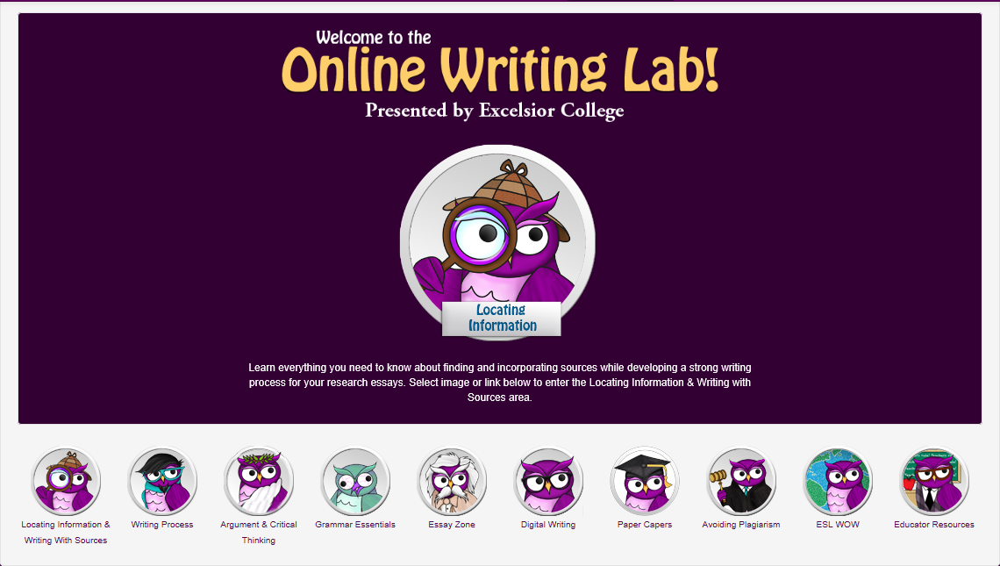
Excelsior College OWL
Notes:
KIM:
The 9 areas of the Excelsior College OWL are:
Locating Information & Writing with Sources
Writing Process
Argument & Critical Thinking
Grammar Essentials
Essay Zone
Digital Writing
Paper Capers
Avoiding Plagiarism
ESL WOW
Now available is an Educator Resources section for those institutions and faculty members looking to use the OWL in their courses.
It contains warm, fun and engaging lessons with memes and pop culture and has multimedia built into each lesson in the form of animations, videos, interactive quizzes and video games.

Slide 11

Educator’s Handbook
Technical Requirements
Overview & Benefits
Excelsior College OWL & Instruction
Using the OWL in Programs & Classrooms
Sample Course Activities
Using for Writing Feedback
OWL Across Disciplines
Process for Embedding the OWL
Notes:
KIM:
Because the OWL is so media rich, engaging and comprehensive, it works well as a unique writing resource, no matter your class format. (Flipped Classrooms – Eliminating Lecture, Online & Hybrid Classrooms).
The Educator Resources Handbook has been created by our OWL team to provide educator’s with a resource for the implementation of the Excelsior College OWL into their coursework whether in its entirety or in pieces.
The following material is provided for educator’s in our handbook with a how-to approach for easy implementation.

Slide 12


Pilot Study
Fall Semester 2013
Developed Common Curriculum
Measured Effectiveness
Results – 6.6 Points Higher
Participating Institutions
  Excelsior College, Valencia College, Howard Community College, Broome Community College, Union County College, San Diego Mesa College
Conducted by the Evaluation Consortium at the State University of New York at Albany
Notes:
LISA:
A pilot study was conducted during the fall semester of 2013 and involved 152 students from six institutions of higher education. The results of our study illustrate the success that the OWL can have in the classroom.
Preliminary findings indicated that students in the courses offering the OWL as a writing resource scored on average 5.5 points higher on their class assignments – on a scale of 100 – than students in the control group. Upon further analysis, students using the OWL scored 6.6 points higher than the control group. This is equivalent to a half letter-grade improvement at the end of a course.
The treatment groups had the OWL integrated into the curriculum and were required to use the OWL as support on all written assignments. Students in the treatment groups reported greater improvements in their perceptions of writing, were able to better articulate writing process rhetorical concepts and showed greater improvements in key categories in the essay rubric, which measured the purpose of writing and use of sources and evidence. The additional analysis showed improvement when comparing students writing from the beginning of the semester to the end of the semester.

Slide 13

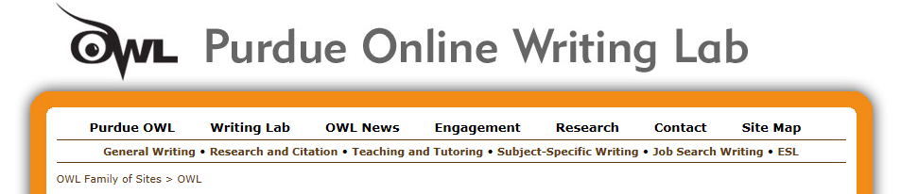
The Purdue OWL
https://owl.english.purdue.edu/owl/
Began in 1993
20th Anniversary
1st Online Writing Lab
Free
Accessibility
Notes:
LISA:
The Online Writing Lab (OWL) at Purdue University houses writing resources and instructional material, and provides these as a free service of the Writing Lab at Purdue. Students, members of the community, and users worldwide will find information to assist with many writing projects. Teachers and trainers may use this material for in-class and out-of-class instruction.
The Purdue University Writing Lab and Purdue Online Writing Lab (OWL) assist clients in their development as writers—no matter what their skill level—with on-campus consultations, online participation, and community engagement. The Purdue OWL offers global support through online reference materials and services.
It offers over 200 free resources including: Writing and Technical Writing, Research, Grammar and Mechanics, Style Guides, ESL (English as a Second Language), Job Search and Professional Writing.

Slide 14
Poll
How many of you are being asked to use OER in the classroom?
Notes:
LISA:
If you aren’t being asked? Why not? Why are people afraid of OER?

Slide 15
Example #1 – English 101
At Excelsior College, the OWL was used to replace textbooks in the English 101 course, saving students approximately $125,000 total each year. Because the OWL has such comprehensive and engaging coverage of writing content and is closely linked to the Framework for Success in Post Secondary Writing, it is a strong resource for any college writing course. And, unlike other OWLs, the learning areas in the Excelsior College OWL are scaffolded, making these learning areas a good fit for a similarly scaffolded writing curriculum.
Notes:
KIM:
I use parts of the Towson State University OWL for parts of speech and usage and provide students with a link to the exact page that speaks to the particular issue they are having. I have used this since 2011 with my students when teaching at Leeds University in England because they not only improved, but saw (and they fed back to me) how quickly they were able to learn the convention because of the short, focused explanation/examples.
Wendy Trevor, PhD
Executive Director
Center for Excellence in Teaching, Learning and Assessment (CETLA)
Office of Student and Faculty Services

Slide 16
Example #2 - Psychology
Houston Community College adopted an open textbook for a psychology class during the fall semester of 2011 for 690 students. They stated, “compared with students using a traditional text in the spring of 2011, student who used the free online textbook scored higher on departmental final examinations, had higher grade point averages in the class and had higher retention rates.”
Notes:
KIM:

Slide 17
Support Across Disciplines
A Students College Experience Involves Writing
Not Just English/Writing
Resources Beneficial to All Disciplines
  Locating Information & Writing With Sources
  Grammar Essentials
  Writing Process
Add This To Your Resource List
Promote to Students
Notes:
LISA:
As can be seen through our previous two examples, OWL’s and OER’s are not just great resources for English and Writing courses. A large part of a students college experience involves writing, regardless of their major or the course they are taking.
Implementation of an OWL or pieces of an OWL provide faculty and students the ability to use open resources to enhance the learning that is being done in the classroom and build upon areas that may be difficult for some students.
Examples include:
(1) Locating Information & Writing With Sources – This sections brings a student through the process of writing a traditional research paper, including locating, evaluating and integrating source materials, but can also help with additional writing assignments.
(2) Writing Process – This section focuses on the steps of a thorough writing process (Think about the assignment, develop ideas, narrow the topic, gather information, order and drafting, revising and editing).
(3) Grammar Essentials – This section provides a thorough overview of punctuation, grammar and usage and some of the most common errors students in the United States struggle with.
While we have just reviewed (3) sections of the Excelsior College OWL that are beneficial across disciplines, if you take a closer look at the OWL overall, you will see various other sections (including Avoiding Plagiarism) that could benefits your students today and in the future.
Regardless of the course you are teaching, I’m sure you can think of an instance where some of or all of these examples would have benefited at least one of your students. If you are not ready to replace your textbook with an OWL, it might be beneficial to add this as a resource to your students and suggest it when you see students struggling.

Slide 18
Getting Started
4 Steps
  Start with your curriculum goals and involve faculty from the start
  Offer high quality professional development – early and often
  Find the OER that is right for your students
  Use OER to customize curriculum and differentiate learning
Is Your Institution Ready?
Notes:
LISA:
So how do you implement?
Aligning any new program with existing educational goals is critical and moving to OER is no different. OER use that directly supports identified curriculum goals is much more likely to be widely embraced and sustainable—and advance student learning. Equally important is teacher buy-in. OER programs implemented from the top down without teacher involvement are not as likely to succeed as those that involve faculty upfront.
Faculty involvement begins with grounding educators in a solid understanding of basic copyright law, intellectual property issues, and how open licenses work. In particular, many people are consistently confusing ‘free’ with ‘open.’” (If you’re not sure of the difference yourself, see “Free vs. Open,” p. 41.)
As a starting point in using OER, schools need to identify high priority content standards. Then, searching for open resources that address those standards at the appropriate level can happen with a variety of online tools, including: OER Commons and their
One of the great advantages of using OER is that you no longer have to live with the one-size-fits-all world of conventional textbooks and canned curriculum. You can customize curricula to meet the needs of their learners with OER.
(Source: Fasimpaur, K. (2012). 4 Steps to Getting Started with OER. T.H.E. Journal, 39(8), 37-40)

Slide 19
Poll
Whose ready to get started?
Notes:
LISA:

Slide 20
Thank You
  Excelsior College OWL Team
    owl@excelsior.edu
  Kim Lourinia
    Assistant Director of Academic Partnerships
    (518) 608-8321
    klourinia@excelsior.edu
  Lisa LaVigna
    Executive Director of Outreach and Access
    (608-8252)
    llavigna@excelsior.edu
Notes:
KIM:
Thank you.

