Slide 1
Roadmap for Intrusively Engaging Students:
Program Completion and Beyond
League of Innovation in the Community College 2017 conference
Johnson County Community College
March 14, 2017
This workforce product was funded by a grant awarded by the U.S. Department of Labor’s Employment and Training Administration. The product was created by the grantee and does not necessarily reflect the official position of the U.S. Department of Labor. The U.S. Department of Labor makes no guarantees, warranties, or assurances of any kind, expressed or implied, with respect to such information, including any information on linked sites and including, but not limited to, accuracy of the information or its completeness, timeliness, usefulness, adequacy, continued availability, or ownership.
Notes:
Deb

Slide 2
ACTTS Grant Team
Deb Elder, Ed.D., Asst. Dean, Comp Sci/Info Tech
Gretchen Sherk, Grant Program Director
Linda Dubar, Career Coach
Kayla Harrity, Career Coach
Denise Griffey, Research Data Analyst
Mindi Schwartz, Research Data Analyst
Debbie Herrig, Administrative Assistant
This workforce product was funded by a grant awarded by the U.S. Department of Labor’s Employment and Training Administration. The product was created by the grantee and does not necessarily reflect the official position of the U.S. Department of Labor. The U.S. Department of Labor makes no guarantees, warranties, or assurances of any kind, expressed or implied, with respect to such information, including any information on linked sites and including, but not limited to, accuracy of the information or its completeness, timeliness, usefulness, adequacy, continued availability, or ownership.
Notes:
Deb

Slide 3
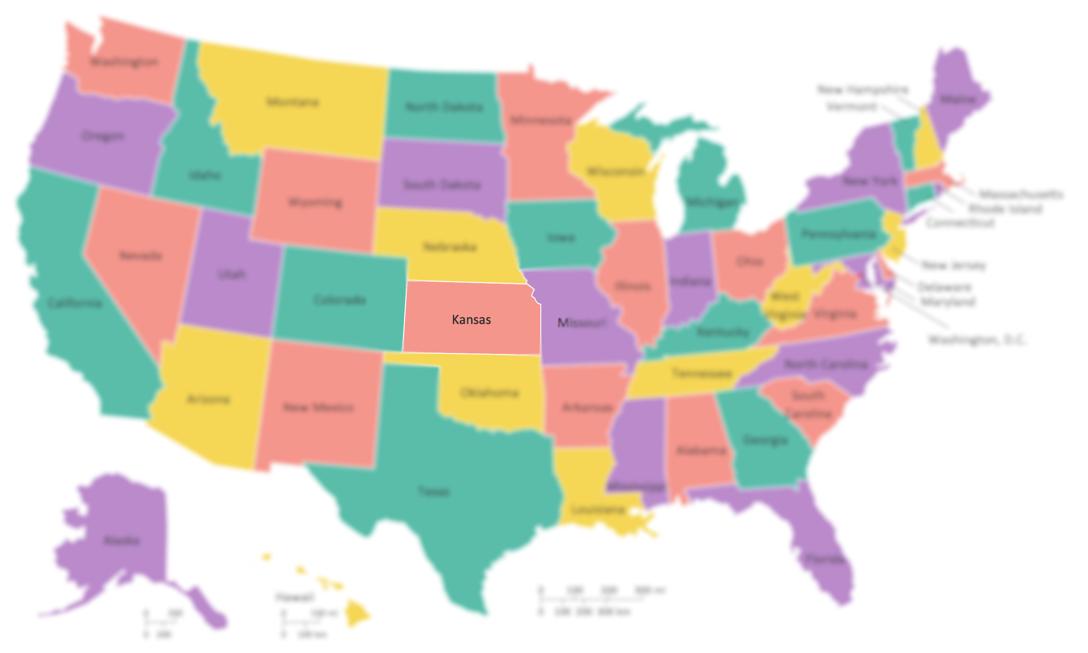
Where Is Kansas?!
This workforce product was funded by a grant awarded by the U.S. Department of Labor’s Employment and Training Administration. The product was created by the grantee and does not necessarily reflect the official position of the U.S. Department of Labor. The U.S. Department of Labor makes no guarantees, warranties, or assurances of any kind, expressed or implied, with respect to such information, including any information on linked sites and including, but not limited to, accuracy of the information or its completeness, timeliness, usefulness, adequacy, continued availability, or ownership.
Notes:
Deb

Slide 4
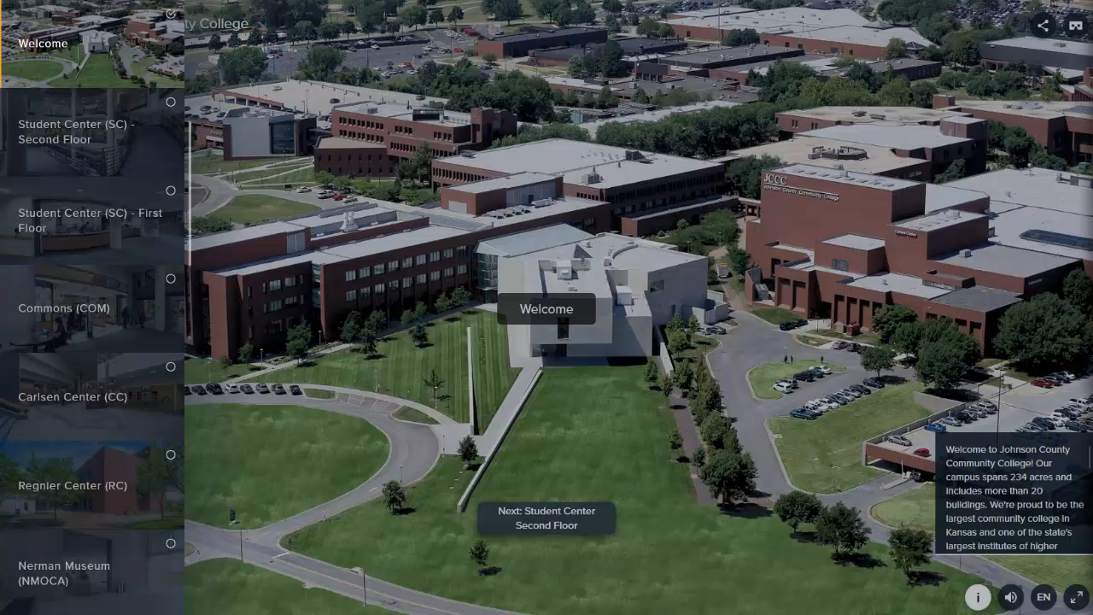
Virtual Tour of JCCC
This workforce product was funded by a grant awarded by the U.S. Department of Labor’s Employment and Training Administration. The product was created by the grantee and does not necessarily reflect the official position of the U.S. Department of Labor. The U.S. Department of Labor makes no guarantees, warranties, or assurances of any kind, expressed or implied, with respect to such information, including any information on linked sites and including, but not limited to, accuracy of the information or its completeness, timeliness, usefulness, adequacy, continued availability, or ownership.

Slide 5
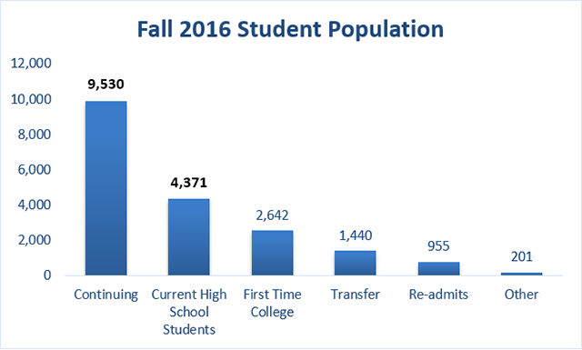
Johnson County Community College Facts
48 programs of study – 116 degree and certificate options
83% of program completers are employed
Fall 2016 Credit Enrollment – 19,139 Students
  Full-Time – 32%
  Part-Time - 68%
This workforce product was funded by a grant awarded by the U.S. Department of Labor’s Employment and Training Administration. The product was created by the grantee and does not necessarily reflect the official position of the U.S. Department of Labor. The U.S. Department of Labor makes no guarantees, warranties, or assurances of any kind, expressed or implied, with respect to such information, including any information on linked sites and including, but not limited to, accuracy of the information or its completeness, timeliness, usefulness, adequacy, continued availability, or ownership.
Notes:
Deb

Slide 6

Aaron J. Monson
“I am a student at Johnson County Community College pursuing an Associates of Applied Science in Web Development & Digital Media with an emphasis on Digital Media…In my past I was not a supporter of the educational system; after my high school graduation in 2008, I fought with the idea of college for years…I worked various positions with a variety of companies in multiple states. It wasn't until June of 2015, after a work force injury, that I knew an education was necessary to better my health, living conditions, as well as my wellbeing…As the first semester rolled forward, I was lined up with Kayla Harrity, my Career Coach, who motivated me to keep up my efforts…I began networking with other staff, faculty, and students. These conversations led to myself and others founding the Web Development Club (aka the Web Club) for Johnson County Community College…This also led to my involvement and eventual employment as the Marketing and Web Manager for the JCCC ECAV Student-Run Radio….I am scheduled to graduate in May of 2017 and I couldn’t be happier with my education up to this point.”
This workforce product was funded by a grant awarded by the U.S. Department of Labor’s Employment and Training Administration. The product was created by the grantee and does not necessarily reflect the official position of the U.S. Department of Labor. The U.S. Department of Labor makes no guarantees, warranties, or assurances of any kind, expressed or implied, with respect to such information, including any information on linked sites and including, but not limited to, accuracy of the information or its completeness, timeliness, usefulness, adequacy, continued availability, or ownership.
Notes:
Kayla

Slide 7

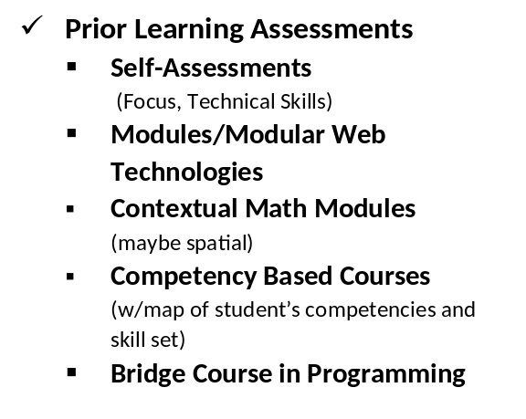
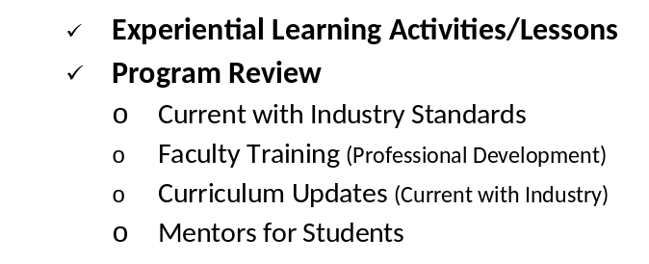
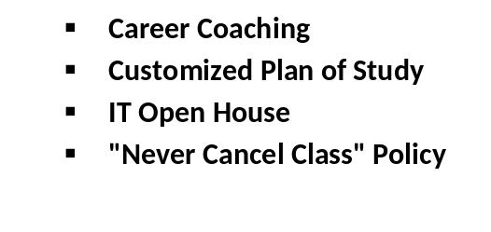
ACTTS Programs
Purpose: Individualized Accelerated Student Learning in CS/IT
Flexible Curriculum
B.I.L.T. Business & Industry Leadership Team
Support Services
This workforce product was funded by a grant awarded by the U.S. Department of Labor’s Employment and Training Administration. The product was created by the grantee and does not necessarily reflect the official position of the U.S. Department of Labor. The U.S. Department of Labor makes no guarantees, warranties, or assurances of any kind, expressed or implied, with respect to such information, including any information on linked sites and including, but not limited to, accuracy of the information or its completeness, timeliness, usefulness, adequacy, continued availability, or ownership.
Notes:
Gretchen

Slide 8
Collaboration with Competency Based Education
Student Services
Design Part of Term
Academic Affairs
Scheduling Curriculum Design
Marketing
Web information mapping
Financial Aid policy
Team
Paul Kyle, Leslie Quinn
Christal Williams, Rick Moehring
Andrew Lutz, Mazen Akkam
This workforce product was funded by a grant awarded by the U.S. Department of Labor’s Employment and Training Administration. The product was created by the grantee and does not necessarily reflect the official position of the U.S. Department of Labor. The U.S. Department of Labor makes no guarantees, warranties, or assurances of any kind, expressed or implied, with respect to such information, including any information on linked sites and including, but not limited to, accuracy of the information or its completeness, timeliness, usefulness, adequacy, continued availability, or ownership.
Notes:
Gretchen

Slide 9
ACTTS Data Management Chart
JCCC Student Level Data
Annual Performance Report
Cohort Performance Report
Kansas Commerce Data
K-State/Office of Educational Innovation & Evaluation (OEIE)
Wage Records
Implementation Analysis
Participant Outcome Analysis
This workforce product was funded by a grant awarded by the U.S. Department of Labor’s Employment and Training Administration. The product was created by the grantee and does not necessarily reflect the official position of the U.S. Department of Labor. The U.S. Department of Labor makes no guarantees, warranties, or assurances of any kind, expressed or implied, with respect to such information, including any information on linked sites and including, but not limited to, accuracy of the information or its completeness, timeliness, usefulness, adequacy, continued availability, or ownership.
Notes:
Denise

Slide 10
Departmental Collaboration with Data Points
Institutional
Research
Build prototype
Capture historical records
Information
Services
Extract data in timely manner
EDW access
Student Services
Build Banner attribute
Access to registration data
Write scripts for data elements
Go to for questions
This workforce product was funded by a grant awarded by the U.S. Department of Labor’s Employment and Training Administration. The product was created by the grantee and does not necessarily reflect the official position of the U.S. Department of Labor. The U.S. Department of Labor makes no guarantees, warranties, or assurances of any kind, expressed or implied, with respect to such information, including any information on linked sites and including, but not limited to, accuracy of the information or its completeness, timeliness, usefulness, adequacy, continued availability, or ownership.
Notes:
Denise

Slide 11
Third Party Evaluator Key Points
Team Member feedback:
  No one dissatisfied
  Good communication established; continue to expand and share
  Benefits of students working w/Career Coaches have been evident
Student feedback:
  Strengths: career coaches, faculty/instructors, course format, curriculum content
  Most utilized 3 student services – Career Development Center, Career Coach support, Financial Aid
Business/Industry feedback:
  Satisfaction w/amount of info shared and amount of progress being made
  Greatest value of participation is:
    Sharing info on employer needs
    Increasing the pipeline of skilled workers w/better trained grads
    Networking/building relationships
This workforce product was funded by a grant awarded by the U.S. Department of Labor’s Employment and Training Administration. The product was created by the grantee and does not necessarily reflect the official position of the U.S. Department of Labor. The U.S. Department of Labor makes no guarantees, warranties, or assurances of any kind, expressed or implied, with respect to such information, including any information on linked sites and including, but not limited to, accuracy of the information or its completeness, timeliness, usefulness, adequacy, continued availability, or ownership.
Notes:
Denise

Slide 12

Timothy Landwehr
“I am a returning student at JCCC after six years working in other fields. I knew I wanted to transition into the Technology sector but felt uncertain about my direction or how to achieve my goals. Fortunately, I met my future career coach, Linda Dubar, who guided me in my decision to pursue a career in Web Development. From the start, she and her team in JCCC’s ACTTS program gave me advice, inspiration, and motivation to follow through with my career change decision…The most important thing to note, however, is the appropriate platitude: what you get out of it is what you put into it. The road this program takes you on is not necessarily easy, but it is worthwhile. If the idea of having a mentor, coach, and friend from day one appeals to you, join this program.”
This workforce product was funded by a grant awarded by the U.S. Department of Labor’s Employment and Training Administration. The product was created by the grantee and does not necessarily reflect the official position of the U.S. Department of Labor. The U.S. Department of Labor makes no guarantees, warranties, or assurances of any kind, expressed or implied, with respect to such information, including any information on linked sites and including, but not limited to, accuracy of the information or its completeness, timeliness, usefulness, adequacy, continued availability, or ownership.
Notes:
Linda

Slide 13
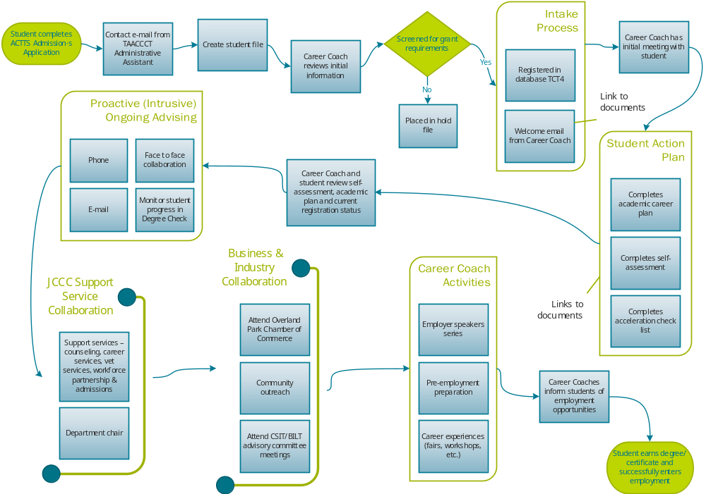
This workforce product was funded by a grant awarded by the U.S. Department of Labor’s Employment and Training Administration. The product was created by the grantee and does not necessarily reflect the official position of the U.S. Department of Labor. The U.S. Department of Labor makes no guarantees, warranties, or assurances of any kind, expressed or implied, with respect to such information, including any information on linked sites and including, but not limited to, accuracy of the information or its completeness, timeliness, usefulness, adequacy, continued availability, or ownership.
Notes:
Linda

Slide 14
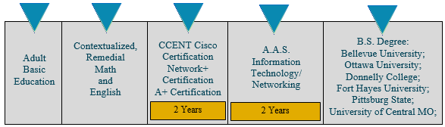
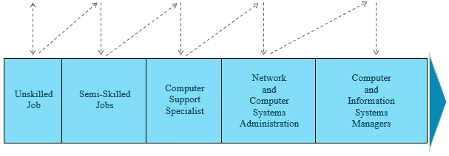
Grant Deliverable
Information Technology/Networking
Career Pathway
Student Support Services
Create replicable models of student support services including a customized educational plan and IT orientation session
This workforce product was funded by a grant awarded by the U.S. Department of Labor’s Employment and Training Administration. The product was created by the grantee and does not necessarily reflect the official position of the U.S. Department of Labor. The U.S. Department of Labor makes no guarantees, warranties, or assurances of any kind, expressed or implied, with respect to such information, including any information on linked sites and including, but not limited to, accuracy of the information or its completeness, timeliness, usefulness, adequacy, continued availability, or ownership.
Notes:
Kayla

Slide 15
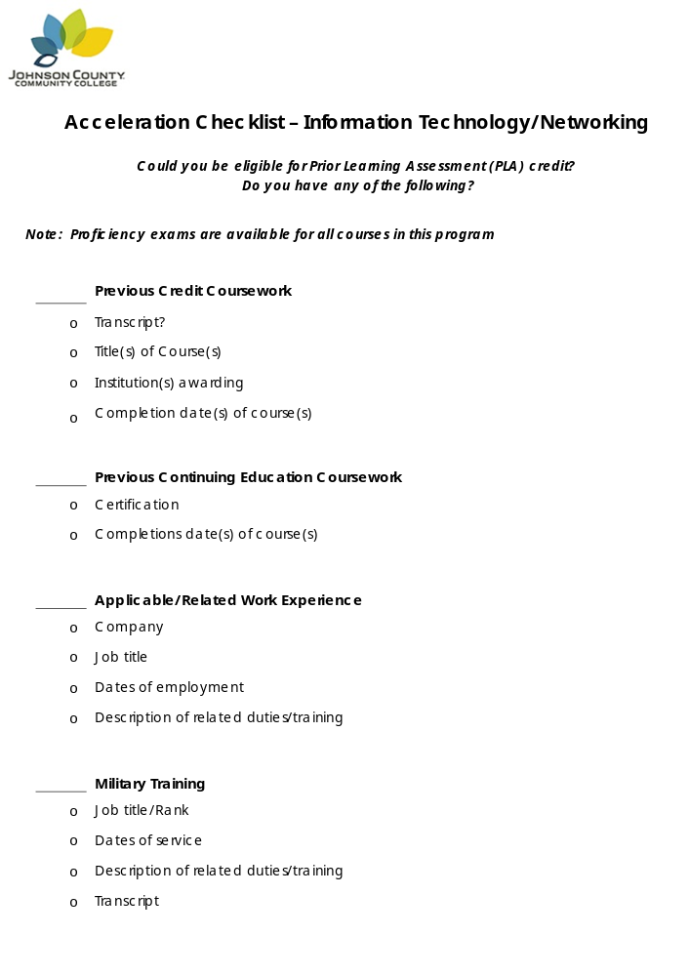
Grant Deliverable
Student Support Services
Create replicable models of student support services including a customized educational plan and IT orientation session
This workforce product was funded by a grant awarded by the U.S. Department of Labor’s Employment and Training Administration. The product was created by the grantee and does not necessarily reflect the official position of the U.S. Department of Labor. The U.S. Department of Labor makes no guarantees, warranties, or assurances of any kind, expressed or implied, with respect to such information, including any information on linked sites and including, but not limited to, accuracy of the information or its completeness, timeliness, usefulness, adequacy, continued availability, or ownership.
Notes:
Kayla

Slide 16

Grant Deliverable
Student Support Services
Create replicable models of student support services including a customized educational plan and IT orientation session
This workforce product was funded by a grant awarded by the U.S. Department of Labor’s Employment and Training Administration. The product was created by the grantee and does not necessarily reflect the official position of the U.S. Department of Labor. The U.S. Department of Labor makes no guarantees, warranties, or assurances of any kind, expressed or implied, with respect to such information, including any information on linked sites and including, but not limited to, accuracy of the information or its completeness, timeliness, usefulness, adequacy, continued availability, or ownership.
Notes:
Linda

Slide 17
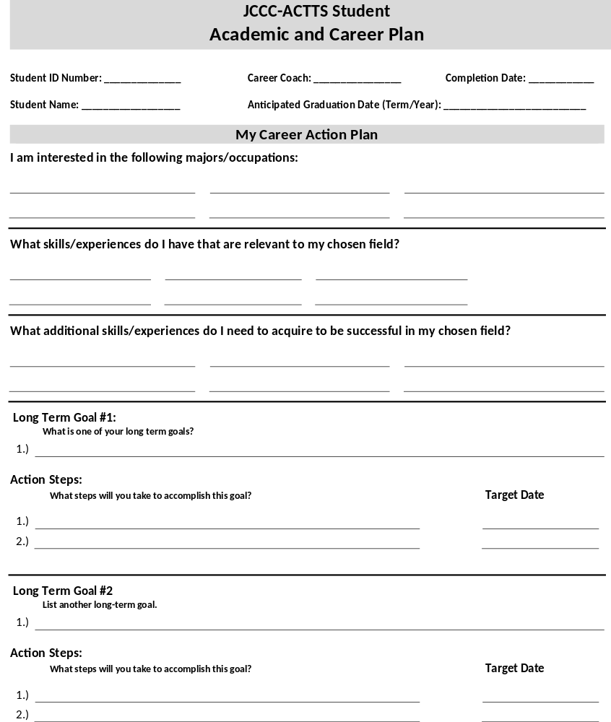
Grant Deliverable
Student Support Services
Create replicable models of student support services including a customized educational plan and IT orientation session
This workforce product was funded by a grant awarded by the U.S. Department of Labor’s Employment and Training Administration. The product was created by the grantee and does not necessarily reflect the official position of the U.S. Department of Labor. The U.S. Department of Labor makes no guarantees, warranties, or assurances of any kind, expressed or implied, with respect to such information, including any information on linked sites and including, but not limited to, accuracy of the information or its completeness, timeliness, usefulness, adequacy, continued availability, or ownership.
Notes:
Linda

Slide 18

Chanel Maddox
“I am a May 2016 graduate of Johnson County Community College. I completed the Health Information Systems Implementation and Support Specialist Certificate program…I have accomplished more than I had imagined in the span of 6 months. I must attest to the amount of support, encouragement, and endless possibilities that Johnson County Community College offers…I am constantly challenged to think big, reach high, and to never give up. My wonderful Career Coach, Linda Dubar, my professors, and staff have guided me and made resources available to enhance my success.”
This workforce product was funded by a grant awarded by the U.S. Department of Labor’s Employment and Training Administration. The product was created by the grantee and does not necessarily reflect the official position of the U.S. Department of Labor. The U.S. Department of Labor makes no guarantees, warranties, or assurances of any kind, expressed or implied, with respect to such information, including any information on linked sites and including, but not limited to, accuracy of the information or its completeness, timeliness, usefulness, adequacy, continued availability, or ownership.
Notes:
Linda

Slide 19
Contact us:
ACTTS Grant Team
Deb Elder, Ed.D., Asst. Dean, Comp Sci/Info Tech
Gretchen Sherk, Grant Program Director
Linda Dubar, Career Coach
Kayla Harrity, Career Coach
Denise Griffey, Research Data Analyst
Mindi Schwartz, Research Data Analyst
Debbie Herrig, Administrative Assistant
Phone: 913-469-8500 Ext. 3453
Web Address: http://www.jccc.edu/admissions/apply/selective-admissions/actts-apply.html
This workforce product was funded by a grant awarded by the U.S. Department of Labor’s Employment and Training Administration. The product was created by the grantee and does not necessarily reflect the official position of the U.S. Department of Labor. The U.S. Department of Labor makes no guarantees, warranties, or assurances of any kind, expressed or implied, with respect to such information, including any information on linked sites and including, but not limited to, accuracy of the information or its completeness, timeliness, usefulness, adequacy, continued availability, or ownership.
Notes:
Gretchen

