Slide 1

Raising the Bar with Concurrent Enrollment
Margo Leone
Assistant Director of Concurrent Enrollment
Front Range Community College, Westminster, CO
Notes:
Does your institution inform, prepare, advise, and transition concurrent enrollment students for success? Attend this thought-provoking session and explore ways to set the tone for success for concurrent enrollment students and your institution. Attendees from student affairs and instruction are encouraged.

Slide 2

Who is in the room?
Take a poll at http://etc.ch/jLWh
Survey Says...
Notes:
Welcome! Thank you for being here today. Today’s topic is all about concurrent enrollment and what we can be doing for this particular student population. Before I get started, I am very interested in knowing who my audience is. So, if you would like to participate, quick jump on to the website here, I have 3 quick questions for you.
Questions:
Who is in the room?
How long have you been working with concurrent enrollment?
What is your comfort level with concurrent enrollment?

Slide 3

Notes:
Now that I know who is in the room, let me take a minute to introduce myself. My name is Margo Leone and I am the Assistant Director of Concurrent Enrollment at Front Range Community College’s Westminster Campus, located just north of Denver.

Slide 4
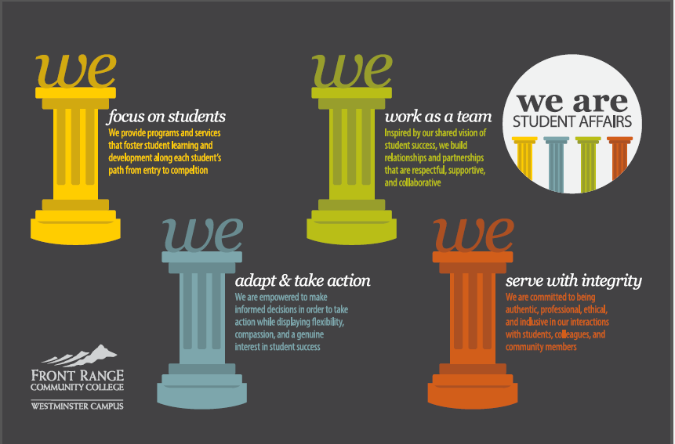
Notes:
I there have been working in this specific field for nearly 7 years there and although my current position reports through instruction, so much of what I do now and my previous higher education experience has all fallen within student affairs including admissions, advising, orientation, career services, testing, and the registrar’s office.

Slide 5

Notes:
Before we get too far down the path today, I want to tackle a little terminology. The National Association for Concurrent Enrollment partnerships or NACEP describes both concurrent enrollment and dual enrollment as partnerships to provide high schools students the opportunity to take college credit-bearing courses.

Slide 6

Notes:
Today, I will utilize NACEPs definition for dual enrollment; however, will use Colorado’s definition for concurrent enrollment. Concurrent enrollment today will include college courses taught at the high school sites, on college campuses, online, Early College models, and PTECH models where credit is earned from day 1 without a final challenge exam like AP and IB.

Slide 7

Notes:
Concurrent Enrollment courses share some elements or characteristics with other dual enrollment models, such as programs where high school students travel to the college campus, college faculty travel to high school sites, or even when a high school student takes a course from a college instructor via distance education or on an online platform.

Slide 8

During the 2010-2011 school year, that National Center for educational Statistics found that more than 1.2 million high school students took courses for college credit within a dual enrollment program.
Notes:
Now that we have the terminology, let’s chat a little bit about data. Looking back to the 2010-2011 school year, that National Center for educational Statistics found that more than 1.2 million high school students took courses for college credit within a dual enrollment program.

Slide 9
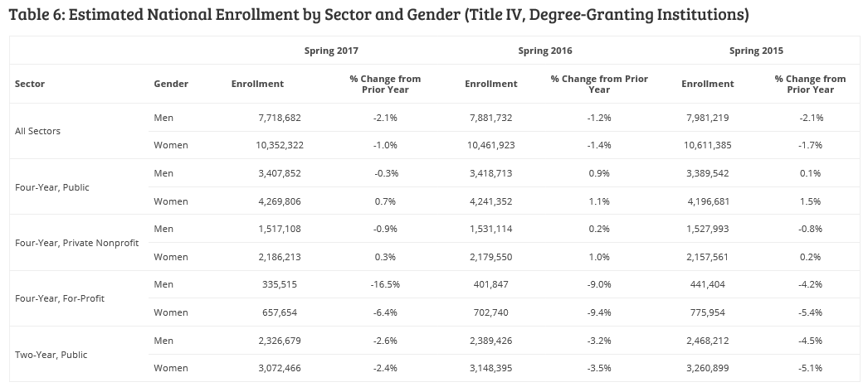
According to National Student Clearinghouse Research Center
Notes:
According to the national student clearinghouse research center, enrollment at community colleges nationwide fell 2.5% from the spring 2016 to spring 2017 semesters. But even though national community college enrollment has declined, concurrent enrollment participation continues to rise.

Slide 10
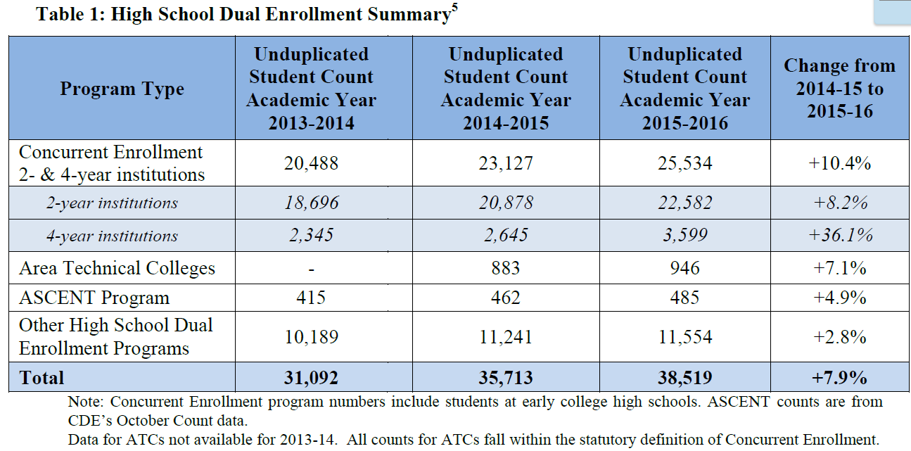
Taken from CDE and CDHE’s Annual Concurrent Enrollment report 2015-2016
Notes:
Colorado specifically has also seen significant growth in this area. In 2009, there were 5,000 students participating in dual enrollment options (encompassing AP, IB, concurrent enrollment, and others). In the 2015-2016 school year, there were more than 38,000 students in dual enrollment options. 25,000 of those students were concurrent enrollment specific.

Slide 11
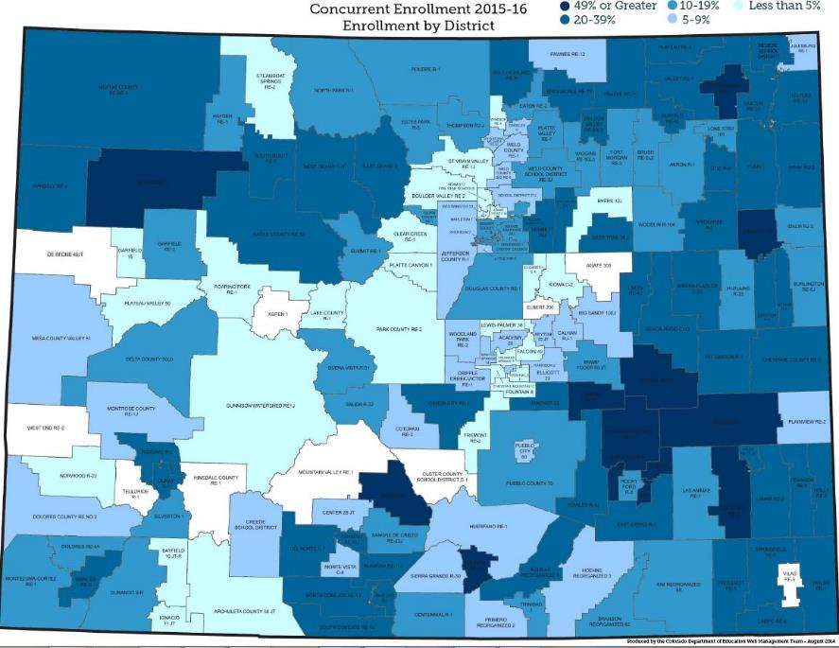
2015-2016
94% of districts
84% of high schools
Notes:
According to a joint report put out by the Colorado Department of Higher Education and Colorado Department of Education each year, in 2015-2016, 94% of Colorado districts and 84% of high school participated in concurrent enrollment.

Slide 12
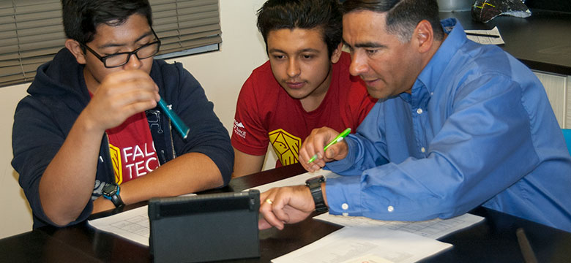
From the 2009-2010 school year to 2015-2016 school year, participation in dual enrollment options increased 27% for Hispanic/Latino students, 65% for African American Students, and 12% for Native American/Alaskan Native students.
Notes:
A rising tide raises all ships and concurrent enrollment is just one example of how Colorado plans to close the attainment gap and tackle the “Colorado Paradigm” . From the 2009-2010 school year to 2015-2016 school year, participation in dual enrollment options increased 27% for Hispanic/Latino students, 65% for African American Students, and 12% for Native American/Alaskan Native students.
The Colorado Paradigm is that CO is one of the most educated states; however, most of the people that live in Colorado with higher education experience were educated elsewhere and moved to CO. The number of CO natives that continue into higher ed and earn degrees is very low.

Slide 13
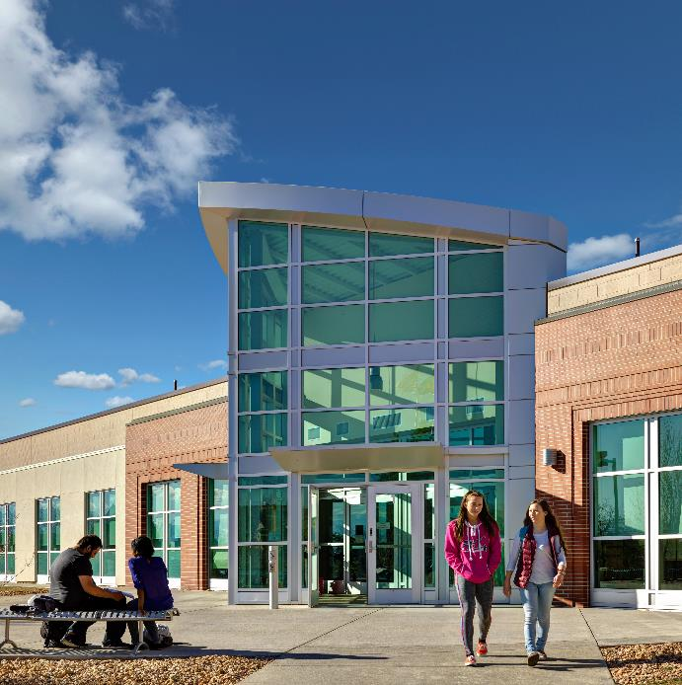


Westminster Campus
Westminster, Colorado
Library
Welcome Center
Notes:
Zooming in a little bit more, remember, I am representing Front Range Community College, which is the largest of the 13 community colleges in the state.

Slide 14
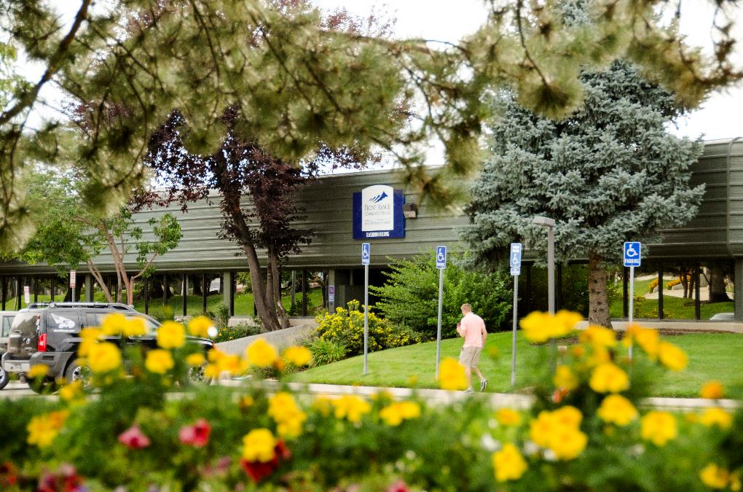
Boulder County Campus
Longmont, Colorado
Notes:
Front Range is a multi-campus institutions with 5 different locations and serves nearly 20,000 students. Campus locations include Westminster Campus, Boulder County Campus in Longmont, and Larimer County Campus in Ft. Collins. 2 smaller centers are located in Loveland and Brighton

Slide 15
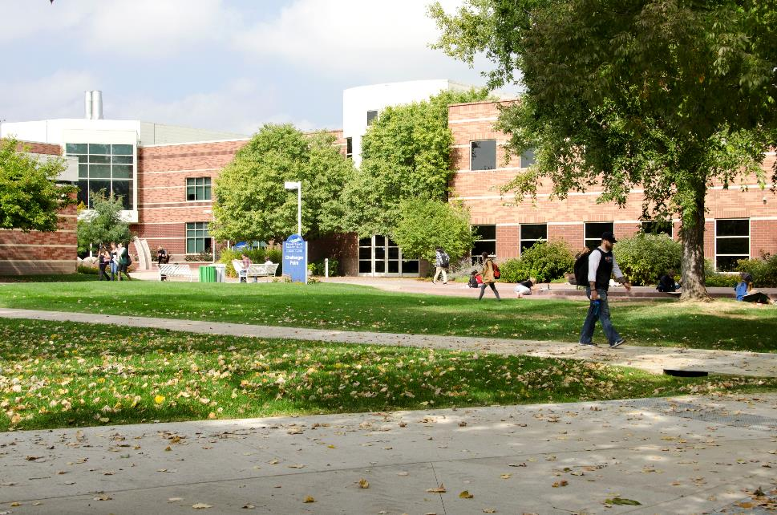
Larimer Campus
Fort Collins, Colorado
College wide
Nearly 20,000 students
Fall 2016
3.469
CE students
Notes:
Of the nearly 20,000 students, Front Range Community College served in fall 2016, 3,469 were concurrent enrollment students.

Slide 16

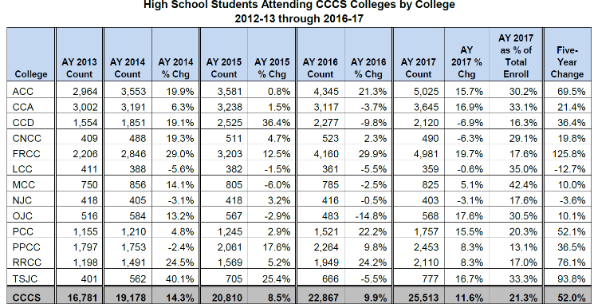
Concurrent Enrollment Growth
Notes:
According to the Colorado Community College System Fact Book, Front Range Community College saw a 125.8% change in enrollment of concurrent enrollment students between the 2013 and 2017 academic years.

Slide 17

During 2015-2016, concurrent enrollment students at FRCC earned 29,035 credit hours and saved nearly $6 million dollars in tuition to students
Notes:
During 2015-2016, concurrent enrollment students at FRCC earned 29,035 credit hours and saved nearly $6 million dollars in tuition to students. CE tuition is paid by the districts in Colorado using per pupil funding from the state.

Slide 18
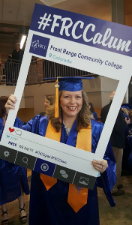
“Greater are the forces inside of you than those that will try to stop you.”
~ Vanessa Crandell
Notes:
According to the Colorado Department of Higher Education, Students participating in concurrent enrollment were 23% more likely to enroll in college after high school.

Slide 19

Not only are more students enrolling in college after high school, but there was an 11% decreased need for remediation, a 3% increase in first year retention rates, and a slight increase in first year GPA.
Notes:
Not only are more students enrolling in college after high school, but there was an 11% decreased need for remediation, a 3% increase in first year retention rates, and a slight increase in first year GPA.

Slide 20

FRCC Westminster and Brighton campuses had 1,352 graduates during the 2016-2017 school year.
Nearly 10% of them were concurrent enrollment.
Notes:
FRCC Westminster and Brighton campuses had 1,352 graduates during the 2016-2017 school year. Nearly 10% of them were concurrent enrollment students earning their certificate or associates degree.

Slide 21
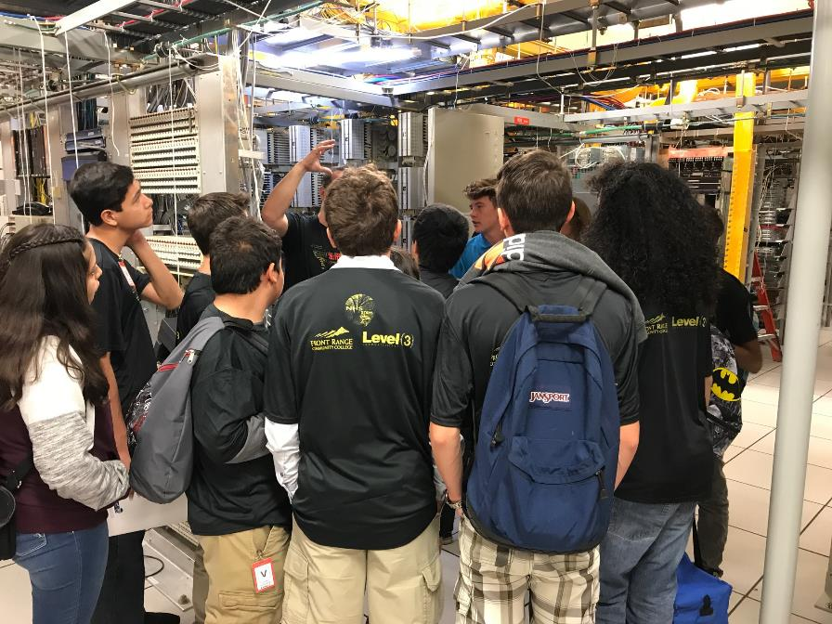
Spring 2018
College wide =
4,309 CE students
Westminster Campus = 1,503 students
43 different high schools
Notes:
This spring, FRCC is serving 4,309 concurrent enrollment students total. Westminster Campus is serving 1,503 of those students from 43 different high schools.

Slide 22

Notes:
So what does all this mean? As you can see by the quick data points shared thus far, concurrent enrollment students are a population we cannot ignore in Colorado or nationwide.

Slide 23
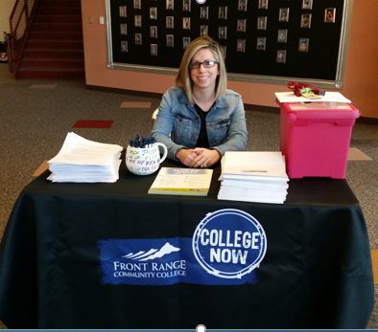


“The secret of change is to focus all your energy not on fighting the old, but on building the new!
~Socrates
I’m FRCC Student Ready
Notes:
For most of you, this data (or similar data) probably isn’t new. But what do we do with it? How can we best be serving this growing population and promote success? Maybe you can’t help but think, “These students are taking over the college!” I’m here to share with you how FRCC’s College Now team embraced our college’s new motto of being student ready.

Slide 24
WHAT IS A STUDENT?
A STUDENT is the most important person in any educational institution.
A STUDENT is not dependent on us. We are dependent on him/her.
A STUDENT is not an interruption of our work. He/she is the purpose of it.
A STUDENT does us a favor when he/she enrolls. We are not doing him/her a favor by serving him/her.
A STUDENT is a part of our work--not an outsider.
A STUDENT is not just a statistic. He/she is a flesh and blood human being with feelings and emotions like us.
A STUDENT is a person who comes to us with his/her needs or wants. It is our job to fill them.
A STUDENT is deserving of the most courteous and attentive treatment we can give him/her.
A STUDENT is the life blood of this and every other educational institution (source unknown).
Notes:
First off, when navigating the world of Concurrent enrollment, don’t panic. Today I’m going to challenge you to possibly rethink concurrent enrollment (CE) at your institution. These students are more than just high school students, they are our students. The experience we provided in CE impacts students matriculating to our campuses after high school, continuing on in higher education. Stop thinking of concurrent enrollment students as high school students on our campuses. These young students are quickly becoming the new normal.

Slide 25

Set the bar from the beginning
Students
Parents
School partners
Faculty/Staff
Notes:
As a higher education institution, don’t be scared, be prepared. Who is driving the bus? Develop strong partnerships. Grow together with partners. Evaluate what works and what doesn’t. Don’t be afraid to charge as necessary to meet the needs of the students.
Why does this all matter?
Think like a recruiter. Every interaction with the student, no matter the age, matters!
Bad experience in high school, they will not continue at your institution after high school.
Retention is about today to tomorrow, not just fall to spring or fall to fall data
Education is key! When working with high school students, you have to be prepared to educate the parents and school partners as well.
The secondary system and the higher ed system (at least in CO) can sometimes feel like putting a square peg in a round hole. Most importantly, don’t forget about your own college staff and faculty. Don’t assume they understand why high school students are showing up in their classrooms. Open the doors of communication.

Slide 26

Be Intentional
What are the goals?
Where do we want to get?
What steps can we take to get there?
Avoid back pedaling.
It doesn’t work if the partnership is one sided
Notes:
I know it is hard in higher education, but do your best to be proactive and not reactive. It is important that all players at the table agree on what the goals are, where you are going and how you want to get there. Avoid back pedaling. Plan ahead whenever and where ever possible. Once you give the go ahead, it is really hard to pull back.

Slide 27

Students & Parents
Academics are not everything!
Who is driving the bus?
What else is going on?
You don’t know what you don’t know
Don’t highlight “free” tuition right away (or discounted tuition)
Notes:
It is important to help students, parents, and secondary partners understand that academics are not everything! Just because a student qualifies with high test scores doesn’t mean they have the social or emotional skills to be successful in college course. Help set the bar for students and your program’s reputation. In Student Affairs, there is a lot of talk about “first year experience” for college freshman. Well, with concurrent enrollment, that first year experience may have been 4 years earlier when he or she was a 9th grader. Don’t leave a bad taste in students’ mouths.
Keep a pulse on who is in control. Students must own the process and the experience. When parents take ownership, it typically ends in a disaster. Over motivated parents and under motivated students never ends well. As the economy has shifted, families are starting to put together the pieces that going to a community college first will save them money. Even more enticing is the idea of free college. If your state offers free concurrent enrollment credits to students like Colorado, I would actually caution you about highlighting that as one of the main selling points. “Free College” tends to appeal to more parents than students. It is a great point to talk about, just don’t make it your main point. Remember, if the student doesn’t want it, the success rate decreases. Free college a lot of times motives parents, not students.

Slide 28
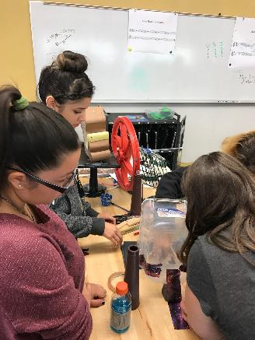
Think about the big picture
Not always the best opportunity for all students at the same time
Look at the big picture
  High School Commitments
  Sports
  Religious commitments
  Family commitments
  Jobs
Scale up (credits, location of courses, etc.)
Course selection and beyond – fielding their environment
Notes:
Think of it this way, Colorado legislation has opened the doors for students in grades 9-12 to patriciate in concurrent enrollment. Would you ever walk into an 8th grade classroom and tell students, “We decided you all are ready to skip high school and jump straight to college”? Most likely not. Concurrent Enrollment is a great opportunity for students; however, it isn’t for everybody. That is where we have to come in and be the coach to help people understand why it isn’t always the best fit at the same time for all students.
Help students understand how college coursework fits into their bigger picture. Is the student taking a full high school course load, play sports, have family or religious commitments after school hours, work, etc. All these pieces add up. Advising is key. What would be best for the student? Possibly fall only classes because of spring sports or theatre productions? Spring courses only because the family always takes a family trip in the fall and the student would miss too much coursework to be successful?
It is also important to remember that you don’t know what you don’t know. Remind students and parents that they don’t need to go from 0 to 60 in 1 semester. Advise on proper course load. At FRCC, we have utilized a scaling method to guide students along. Best practice we have found includes:
Start with a college course at a high school site taught by a qualified high school instructor
Move to a college course at the high school site taught by a full time or part time college instructor coming to the high school
Have the student take coursework at the college site

Slide 29

College Faculty & Staff
Department Chairs
Department meetings
Faculty Senate
Surveys to collect faculty/partner feedback
Notes:
It isn’t enough to just prep the high school students and their parents. It is important to remember that your college faculty and instructors may or may not love the idea of teaching high school students. It is important to support them as well. A couple examples we have used for helping to engage the instructional side of the house has included updates to the department chairs each semester, attending department meetings with faculty to answer questions and navigate hot topics, be willing to gather feedback and do something about it.
Recently we surveyed our partners (internally and externally) about our program. The information we received caused us to start doing some data digs to get to the heart of the program. When you collect the data, don’t forget to close the loop. We communicated back out that the feedback was heard and shared what we were doing internally to help tackle key issues.

Slide 30

Think outside the box
English symposium
  “Be colleague ready”
PTECH
  Brining college, secondary, and industry together
Notes:
Another example came out of our faculty specifically. Our English faculty were finding that high school students were not prepared for their courses even though they were testing in and meeting pre-reqs. At the request of our English faculty, we pulled together the high school English teachers and college faculty to talk about what they are teaching in each of their classrooms and were able to identify why some of the students may struggle once in a college classroom. This has allowed for additional improvements from both sides resulting in benefits for students and promoting being “colleague ready” for faculty. Changing the mindset and making sure the high school teachers teaching on behalf of the college at the high school sites are our colleagues and are truly an extension of the college.
The PTECH program which stands for Pathways in Technology Early College High School is another example of success and has brought secondary, post-secondary and industry together at the table to create seamless opportunities for students. Bringing industry to the table from the start to help select program options that best meet their needs in industry.

Slide 31
Other instructional tips
Hiring credentials – make sure they are clear!
Include college faculty on hiring decisions at high school as appropriate
Be intentional and inclusive with professional development
Insure regular observations (mirror what is done on campus)
Compensation models for faculty overseeing high school sections.
  “What is the job description?”
Notes:
Some additional tips our department has found helpful when working with instructional folks is to make sure you have clear hiring credentials. Documents showing exactly who qualifies. Make sure your secondary partners know what those credentials are. Remember, it is hard to back pedal once the wrong information has been distributed.
Having a hard time filling a position that teaches at a high school site? Consider positing a specific job description identifying it is a teaching opportunity at the high school site. We have found some real gems by doing this. For example, high school teachers that walked away from teaching to be stay at home parents but love their field and jump at the opportunity to teach just 1 class. Having the right people, who are engaged and excited from the start makes a huge difference. Since hiring credentials at the secondary level can be different than the college level, consider working with the high school to have a college department chair review applicant materials to see if the high school teacher would meet college qualifications before their hired. Maybe even have them sit on the search committee for the high school hiring as appropriate. These conversations up front eliminate frustration later on.
Once you have them hired, don’t forget about them! Be intentional about professional development. Are there ways you can include instructors teaching at high school sites with campus department meetings or inservice opportunities? Don’t leave any gaps. Make sure there is clear communication about expectations or changes occurring. We have also created some specific professional development opportunities teaching at the high school sites to make sure they have the nitty gritty of the college culture/processes before we turn them loose. Remember, no matter where the course is being taught, whether it is at a college site, high school site or online, the college has the responsibility to monitor what is happening. Observations for courses at high school sites should mirror things occurring on the college campus. This can be a pain point. Be prepared to hear, “that isn’t in my job description”. Consider making it part of their job description or having some sort of compensation model. For us, we have had large numbers of Psych courses taught at high school sites. The department chair for psych could easily have 10 sections to observe at high school sites in one semester. Chemistry may have none. Having compensation models helps create buy in.

Slide 32
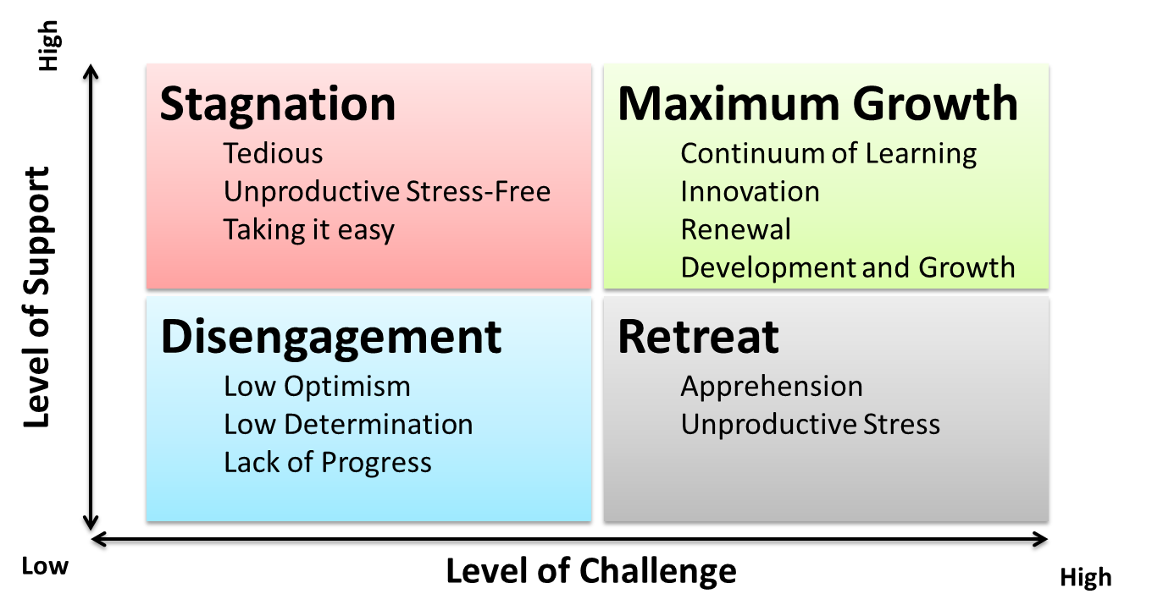
Sanford’s Challenge and Support Theory
Notes:
Maybe you’re thinking these examples are great but where do you start? For all you die hard theorist in the room, check this one out. Our department has really focused on our program as a transition program and the idea of challenge and support. The concepts behind it really work for everybody involved (students, parents, high schools, faculty, college staff, etc.) Think about it. In Sanford’s theory, success comes from a balance. Our goal is to help make sure students can be challenged by college courses; however, the support is key to their success. The last thing we want is to have negative results that can impact students down the road. The same applies to instruction. We challenge college faculty and instructors to teach high school students. If you don’t support them, they become resentful and the classroom environment or partnership will suffer.

Slide 33

Celebrate Success
Fear of going to college
1 class vs a certificate or degree
Finding a niche
Accomplishing goals
New partnerships
Opportunities to learn
Notes:
As you embrace concurrent enrollment in your institution, don’t forget to celebrate success. We spend so much time responding in this constantly changing environment and putting out fires for students, faculty, and staff. Remember, concurrent enrollment may have helped a student realize that can “do” college, or accomplish their goal of 1 course a full degree or certificate. Maybe we helped the student who has never felt like they fit in or could find their niche. Or another student accomplished their goal by taking a challenging course load in high school to get into the Ivy League school of their dreams. Maybe the success is a new internal or external partnership. You may be convinced a college employee that concurrent enrollment really isn’t that bad. And in the end, remember that sometimes you win and sometimes you learn. So it doesn’t always work out well. What are you going to do to fix that? Make the best decision you can with the information you have and keep going.

Slide 34

Questions?
Margo Leone
303.404.5212
Margo.leone@frontrange.edu
Notes:
Those are just some of the examples of ways FRCC has raised the bar with concurrent enrollment to help make sure our students are prepared, coached and support along the way. With that, are there any questions I can answer?

Slide 35
References
An, B. P. (2012). “The Impact of Dual Enrollment on College Degree Attainment: Do Low-SES Students Benefit? Educational Evaluation and Policy Analysis, 35, 57–75.
Bailey, M, and Dynarski, S. (2011). Gains and Gaps: Changing Inequality in U.S. College Entry and Completion. National Bureau of Economic Research. http://users.nber.org/~dynarski/Bailey_Dynarski.pdf
Bean, B. and Poast, K. (2018). Concurrent and Dual Enrollment (Policy brief 2-8). Retrieved from https://highered.colorado.gov/academics/concurrent/
Colorado Community College System Institutional Research. (2017). Fact Book Academic Year 2016-2017. Retrieved from https://www.cccs.edu/wp-content/uploads/documents/Fact-Book-2016-17-Final.pdf

Slide 36
References Continued
Colorado Department of Education and Colorado Department of Higher Education. (2017). Annual Report on Concurrent Enrollment 2015-2016 School Year. Retrieved from https://highered.colorado.gov/Publications/Reports/Enrollment/FY2016/2016_Concurrent_Enrollment_April_2017.pdf
Karp, M, and Hughes, K. (2008). Study: Dual Enrollment Can Benefit a Broad Range of Students. Techniques: Connecting Education and Careers (J1) 83.7, 14-17.
Karp, M. M., Calcagno, J. C., Hughes, K. L., Jeong, D. W., & Bailey, T. R. (2007). The Achievement of Participants in Dual Enrollment: An Analysis of Student Outcomes in Two States. Saint Paul, MN: University of Minnesota, National Research Center for Career and Technical Education.
NACEP. (n.d.). What is Concurrent Enrollment? Retrieved from http://www.nacep.org/about-nacep/what-is-concurrent-enrollment/

Slide 37
References Continued
NACEP. (2014). Research on the Impact of Students Completing Dual and Concurrent Enrollment Courses. Retrieved from www.nacep.org
Pierce, D. (2017). The Rise of Dual Enrollment. Community College Journal, Volume 87 (April/May), 17-24. Retrieved from http://www.ccjournal-digital.com/ccjournal/20170405?pg=19#pg19
Smith, A. (2017, May 31). Double-Edged Sword of Dual Enrollment. Retrieved from https://www.insidehighered.com/news/2017/05/31/dual-enrollment-provides-boost-community-colleges-may-hide-extent-enrollment
Wallace, K. (2017). FRCC Fast Facts Fall 2016. Retrieved from https://www.frontrange.edu/about-frcc/facts-and-figures/fact-book

