Slide 1


ONLINE STUDENT RECRUITMENT
KATHLEEN MICHELL, Ed.D,
DIRECTOR, ALLIED HEALTH
BERYL STETSON, RNBC, MSN,
CHAIRPERSON, HEALTH
SCIENCE EDUCATION
RARITAN VALLEY COMMUNITY COLLEGE, BRANCHBURG, N.J.

Slide 2
Presenters
Dr. Kathleen Michell is the Director of Allied Health at Raritan Valley Community College. She successfully designs, plans, implements, and administers Allied Health course, curriculum, and program policies, including credit-bearing courses, non-credit and external credit courses, occupational certification programs, workforce development, and customized training programs. Dr. Michell earned her BA and MA from Rutgers University and a Doctorate in Educational Leadership from Rowan University. With over 9 years of higher education experience, Dr. Michell’s research interests include gender advantage, fields within allied health, assessment, and online learning.

Slide 3
Presenters
Ms. Beryl Stetson has been a registered nurse for 44 years and a nurse educator for 26 years. Her specialties are Oncology and Maternity. She has been a nurse manager, IV nurse, medical/surgical nurse, and a professional development nurse educator. She is a Lamaze Childbirth Educator, Certified Lactation Consultant, Certified Chemotherapy and Biotherapy nurse and a past CPR instructor. Currently Ms. Stetson is an Associate Professor of Nursing and Chairperson of the Health Science Education Department at Raritan Valley Community College. Her experience includes teaching and development of face-to-face and online credit, non-credit and continuing education courses, and curriculum development and revision. Ms. Stetson received her BSN from College of Staten Island, MSN from SUNY-Downstate and is currently working on her Doctorate of Education at Walden University.

Slide 4
I AM A FUTURE HEALTH CARE PROFESSIONAL
SMART START AT RVCC – INTRODUCTION TO HEALTH CARE CAREER OPPORTUNITES

Slide 5
Grant funding
Trade Adjustment Assistance Community College Career Training (TAACCCT) Round IV Grant was awarded in October 2014
RVCC receives $264,751 per year over a four year period, or just over $1,000,000 for the grant term
The project: NJ Prep, involves Bergen Community College and 10 other community colleges in New Jersey to develop health care laddering and latticing of training throughout the consortium
Project has allowed for the creation of a new occupational Therapy Assistant Program AS

Slide 6
Grant funding
NJ PREP programs at rvcc
Student resources
Certified Nurse Aide
EKG Technician
Health Information Technology AS
Medical Assisting Certificate
Phlebotomy Lab Assistant
Smart Start
  Recruitment tool used to introduced students to Health Care Careers
Networking Sessions
  Resume writing
  Soft skills

Slide 7
SMART START CLASSES
INTRODUCTION TO HEALTH CARE CAREERS
WHO IS THIS CLASS FOR:
HIGH SCHOOL STUDENT OVER 18 YEARS OF AGE
UNEMPLOYED INDIVIDUALS
UNDEREMPLOYED INDIVIDUALS
INDIVIDUALS INTERESTED IN FIRST AND SECOND CAREERS

Slide 8
Purpose of course
To provide information on the Health Care arena in the 21st century
Introduce students to different Health Care careers
Help student determine if they are interested in a Health Care career path
Identify required preparation and education for several Health Care professions
Identify where information on job locations, salary range can be found.

Slide 9
Health Care in the 21st century
4.2 MILLION INCREASE IN HEALTH CARE JOBS IS EXPECTED BETWEEN 2010 AND 2020
63% OF THOSE INCREASED JOBS WILL BE IN AMBULATORY SETTINGS
https://www.healthit.gov/sites/default/files/chws_bls_report_2012.pdf

Slide 10
HEALTH CARE PROFESSIONS
ATHLETIC TRAINER*
CARDIOVASCULAR TECHNOLOGIST
CERTIFIED NURSING ASSISTANT*
CLINICAL CODER/MEDICAL CODER*
DENTAL ASSISTANT*/HYGIENIST
EKG TECHNICIAN*
EMT/PARAMEDIC
HEALTH INFORMATION TECHNOLOGIST*
LANGUAGE INTERPRETOR
MEDICAL ASSISTANT*
NURSE – RN*/LPN
NUTRITIONIST
OCCUPATIONAL/PHYSICAL THERAPIST
OPHTHALMIC TECHNICIAN*
PHARMACY TECHNICIAN*
PHLEBOTOMIST*
RADIOGRAPHER
RESPIRATORY THERAPIST
SONOGRAPHER
SURGICAL TECHNICIAN
THERAPIST
*COURSES/PROGRAMS CURRENTLY OFFERED AT RVCC

Slide 11
Allied Health & nursing at rvcc
Dental Radiology
Electrocardiogram Technician (EKG)
Emergency Medical Technician (EMT)
Exercise Science AS
Health Information Technology AAS
Medical Assisting Certificate
Nursing AAS Degree
Occupational Therapy Assistant Program *proposed program AAS
Ophthalmic Science AAS
Phlebotomy Lab Assistant
Psycho-Social Rehabilitation and Treatment AS* Joint Rutgers Univ. Program
Sports Management Option Exercise Science AS

Slide 12
PROFESSIONAL ASSOCIATIONS AND Web Sites
http://www.adha.org –Dental Hygienist
http://www.CAAHEP.org – EKG tech
http://www.nremt.org – EMT
http://www.paramedicemttraining.com - EMT/Paramedic
http://ccie-accreditation.org – Language Interpretation
http://www.bls.gov/ooh/healthcare/medical-assistants.htm
New Jersey Board of Nursing:
www.state.nj.us/oag/ca/medical/nursing.htm
New Jersey State Nurses Association:
www.njsna.org
National League for Nursing:
www.nln.org
Nursing Information:
www.nursezone.com

Slide 13
PROFESSIONAL ASSOCIATIONS AND WEBSITES
Dental Hygienist - http://www.adha.org
EKG Technician – http://www.CAAHEP.org
EMT - http://www.nremt.org
EMT/Paramedic - http://www.paramedicemttraining.com
Language Interpretation - http://ccie-accreditation.org
Medical Assistant – http://www.bls.gov/ooh/healthcare/medical-assistants.htm
New Jersey Board of Nursing - www.state.nj.us/oag/ca/medical/nursing.htm
National League for Nursing - www.nln.org
Occupational Therapy – www.acote.org
American Association of Respiratory Care – www.aarc.org
Association of Surgical Technologists – http://www.ast.org

Slide 14

Getting started
What information do I need?
Where to look for information? – Located on RVCC LION’s Den
Career Opportunities
Job locations
Salary Ranges
Required education

Slide 15
What is my learning style?
Auditory Learner
Visual Learner
Kinesthetic Learner
Take a free learning style inventory at Pennsylvania State University http://www.personal.psu.edu/bxb11/LSI/LSI.htm

Slide 16

Ed ready – assessment tool
EdReady provides assessment exams which tests students in math, then assists in a customized study path.
Medical assisting was used a basis to ensure proficiency in medical math
Students are tested on:
  Calculations
  Decimals
  Percentages

Slide 17
KEYS TO SUCCESS FOR NEW HEALTHCARE PROFESSIONALS
CRITICAL THINKING SKILLS
PROBLEM-SOLVING SKILLS
PRIORITIZATION
MOTIVATION
TEAM WORK, SENSE OF COMMUNITY

Slide 18
Components of customer service
Accountability
Reliability
Verbal and Written Communication
https://www.youtube.com/watch?v=y2Z4OEhufTQ
https://www.youtube.com/watch?v=W1RY_72O_LQ
Hospital Consumer Assessment of Healthcare Providers and Systems (HCAHPS)
https://www.youtube.com/watch?v=0jPk6CtK360
Exercise: Can you give an example of good customer service?

Slide 19
SUFFIXES THAT Changes a root word to a noun
-CIDE killer
-GEN production of
-ICIAN one charged with
-IST skilled in
-METER measure
-PHYLAXIS protection

Slide 20
ORGANIZATION OF STRUCTURES
ORGANISM
CELLS
TISSUES
ORGANS
SYSTEMS

Slide 21
Role of technology
ELECTRONIC HEALTH RECORDS
HEALTH INFORMATION PORTALS
MEDICAL EQUIPMENT – ELECTRONIC THERMOMETERS, BLOOD PRESSURE MACHINES, TELEPHONIC MEDICINE, MONITORS, DAVINCI ROBOTIC SURGERY

Slide 22
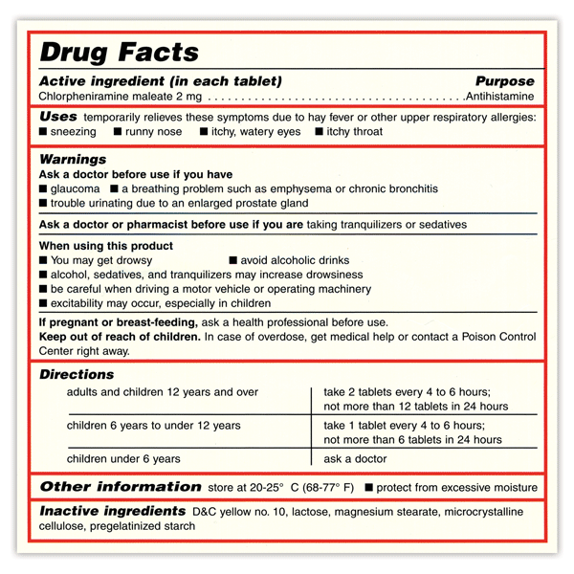
Medication labels
Look at this Over-the- Counter medication label
Find the specific uses of this medication.
What are the potential side effects?
How frequently should this medication be taken?
What is the correct dose for children 6-12 years old?
What does the Warnings mean?
Medical label taken fromhttp://familydoctor.org/familydoctor/en/drugs-procedures-devices/over-the-counter/how-to-read-otc-drug-facts-label.html

Slide 23

THE VITAL SIGNS
Temperature
Pulse
Respiration
Blood Pressure
Most Hospitals Also Require Assessment of:
  Pain Level
  Pulse Oximetry

Slide 24
THE SKY IS THE LIMIT…..
FACE TO FACE – GUEST SPEAKERS – REPRESENTATIVES OF PROFESSIONS
ON-LINE – GUESTS IN FORUM DISCUSSIONS, LEAD AN INDIVIDUAL DISCUSSION OR
HAVE SEVERAL PROFESSIONALS IN A DISCUSSION BOARD
INBED – PROFESSION VIDEOS
INBED – STANDARDIZED TESTING PREP (MATH)
USE SCREENCASTS
GLITCHES….. MARKETING, GETTING STUDENTS REGISTERED WITH LMS ACCESS,
CLEAR INSTRUCTIONS

Slide 25
Targeted Stem recruitment
Social media
Flyers
Local newspapers
Connect to local employers
Target gender-specific audiences to recruit more women in STEM
  Local Girl Scouts and girl clubs
Provide gender and minority- specific mentorships to encourage the under served

Slide 26
Targeted message for stem
Highlight benefits of STEM careers in marketing
  High, livable wages
  Varied careers available
  Evolving and growing industry

Slide 27
ADAPTING FOR OTHER USES
STATE WIDE USE AS SMART START
AFTER THE GRANT …..

