Slide 1
Keeping Students on Track
Using Technological Retention Tools
with Carmen Allen
Innovations 2017 March 13,2017

Slide 2
Carmen Allen - Introduction
Lincoln Land Community College – Springfield, IL
Subject area: Tech classes
Delivery: In-class and On-line
Ferris State University – Big Rapids, MI

Slide 3
Today’s focus
Retention and Success
Of Community College Students
At the Course level
With On-line students
During the 1st few weeks

Slide 4
Retention and Success Viewpoint
Institutional retention initiatives have value.
Course retention initiatives can also be valuable.
Strengthen the focus where students are more likely to drop…
…during their coursework.

Slide 5
Retention tool categories
Improve Communication
Address Learning Barriers
Track Performance

Slide 6

Retention Tool #1–Improve Communication
Problem: Communicating with students
    Email being read?
    LMS (Blackboard) Announcements being read?
    LMS Messaging being read?
Solution: use the most accessible device in the most frequently used format -
  Mobile phone texting

Slide 7
Retention Tool #1–Improve Communication
  Remind APP – Easy to use and Free
      K-12 for homework
      Phone #’s are not shared – kept private
      Family Educational Rights and Privacy Act (FERPA) Compliant
  Faculty use with PC or Phone (www.remind.com)
  Students use with phone (email option provided)

Slide 8

Retention Tool #1–Improve Communication
  Remind APP Interface and Demo

Slide 9

Retention Tool #1–Improve Communication
  Other student interaction stories…

Slide 10
Retention Tool #1–Improve Communication
  Remind APP notes
  Faculty set up a Remind “course”
  Faculty provide course code to students – one code for each class with instructions
  Demo! With Group
  Activate your phone and have it ready!
  Turn volume down

Slide 11
Retention Tool #1–Improve Communication
Remind App Demo “Disclaimers”
  Your full name may be automatically sent to the app
  Your full name will appear in the demo
  After this presentation it will be used for you to receive the PowerPoint of this presentation
  Use this texting option to ask me future questions

Slide 12
Retention Tool #1–Improve Communication
Remind App Instructions for Students
  Compose a new text message on your phone
  In the To box type: 7083848107
  In the Message are type: @iclass44

Slide 13
Retention Tool #1–Improve Communication
Remind App Instructions for Students (continued)
  Hit send
  You may have to provide your name (maybe not)
  Receive a confirmation
  Do not download the REMIND app as instructed
  In the reply box, send a simple message or ask a question

Slide 14

Retention Tool #1–Improve Communication
Demo Remind App Activities

Slide 15
Retention Tool #2 – Address Learning Barriers
Problem:
Couldn’t determine why students were dropping or underperforming
Solution: Student Survey

Slide 16
Retention Tool #2 – Address Learning Barriers
  Student Survey - Google forms - Easy to use and Free
  Quantitative questions - Multiple choice (T/F included), Check boxes, Range of Response
  Qualitative questions – Paragraph, Short answer
  Data Results for all students are aggregated
  Data Results are also individually provided
  Google sheets download (further downloadable to Excel)
  Survey provided via web link
  Demo! With Group - Grab your phones!

Slide 17
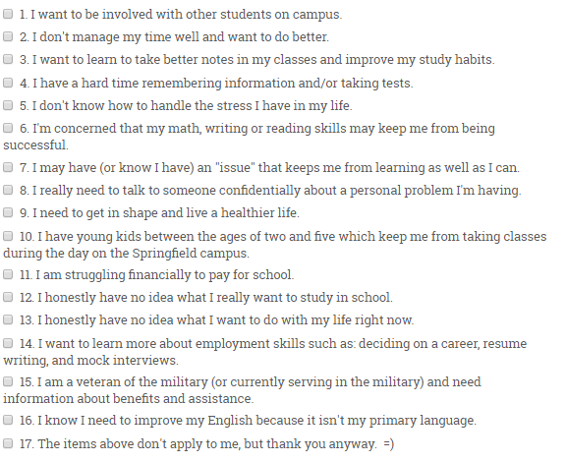
Carmen Allen’s Complete Sample Survey
Question addressing Learning Barriers

Slide 18
Spring 2017 Student Survey results
Over 100 students surveyed in multiple courses
75% Responded with at least one learning barrier
40% Responded with one or more learning barrier
Students could earn extra credit by addressing at least one learning barrier via an information interview
46% Pursued the extra credit option

Slide 19
Q and A’s
about the Student Survey?

Slide 20
Retention Tool #3–Track Performance
Problem: Student progress monitoring and feedback was limited
Solution:
More effective use of Blackboard GRADES for:
  Grade and Performance Evaluation
  Additional “Red Flag” Field
  Additional “Instructor Feedback” field

Slide 21
Retention Tool #3–Track Performance
  1. Grade and Performance Evaluation
    Column Sorting (high/low)
    Last Access date
    Last Submission of assignment work date
    High/Low score performance
    Running totals

Slide 22
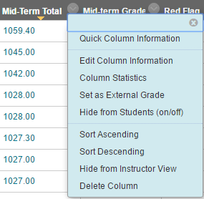
Retention Tool #3–Track Performance
  1. Grade and Performance Evaluation

Slide 23
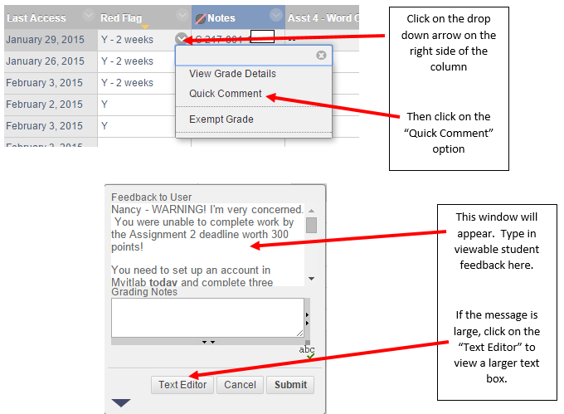
Retention Tool #3 – Track Performance
  2. Additional “Red Flag” text Field
Family Educational Rights and Privacy Act
Family Educational Rights and Privacy Act
Family Educational Rights and Privacy Act

Slide 24
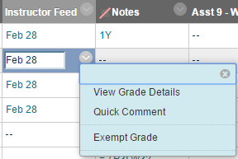



  3. Additional “Instructor Feedback” text Field

Slide 25
Q and A’s about
using Blackboard Grades?

Slide 26
Overall Tools Impact on Retention
Four courses from Fall 2014 – Fall 2016
One course in-class, three courses on-line
The number of retention tools gradually increased for all courses over this time period
Fall 2014 - Retention rates ranged from 75%-95%
Fall 2016 - Retention rates for all classes were above 85%

Slide 27
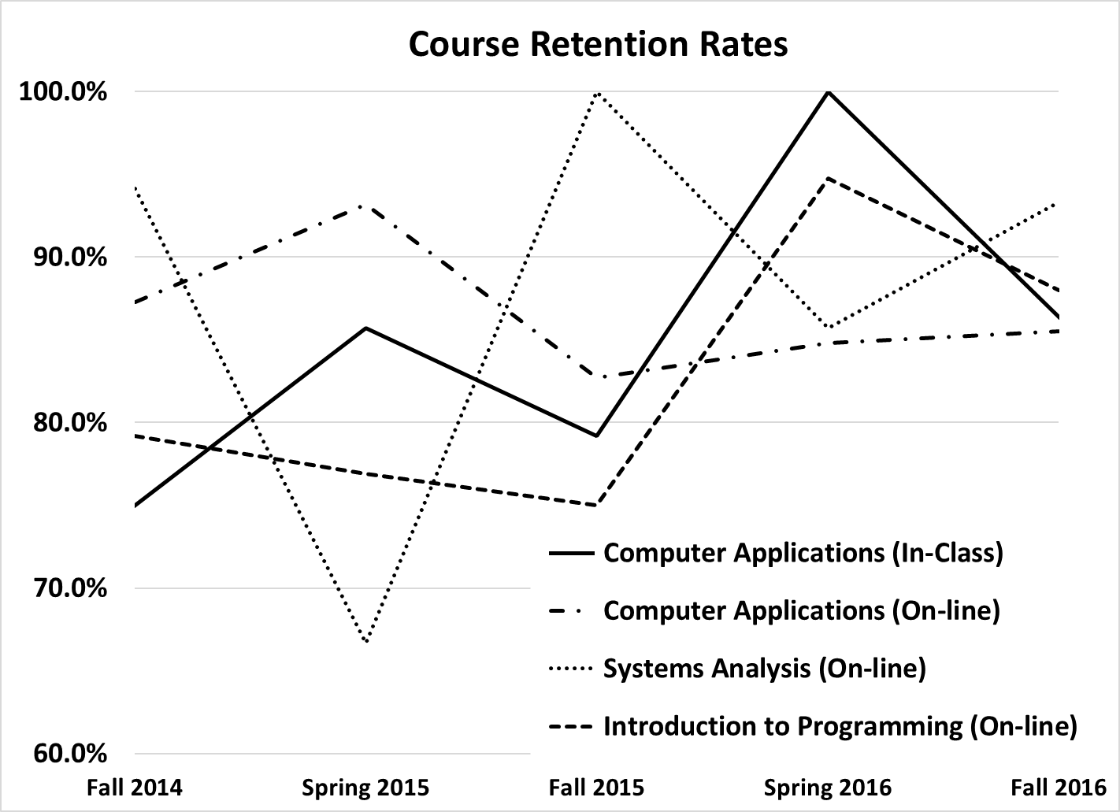

Slide 28
Overall Tools Impact on Success
Students completing with an A, B or C grade
Four courses from Fall 2014 to Fall 2016
Fall 2014 - lowest Success rate of 60%
Fall 2016 - lowest Success rate of 78%

Slide 29
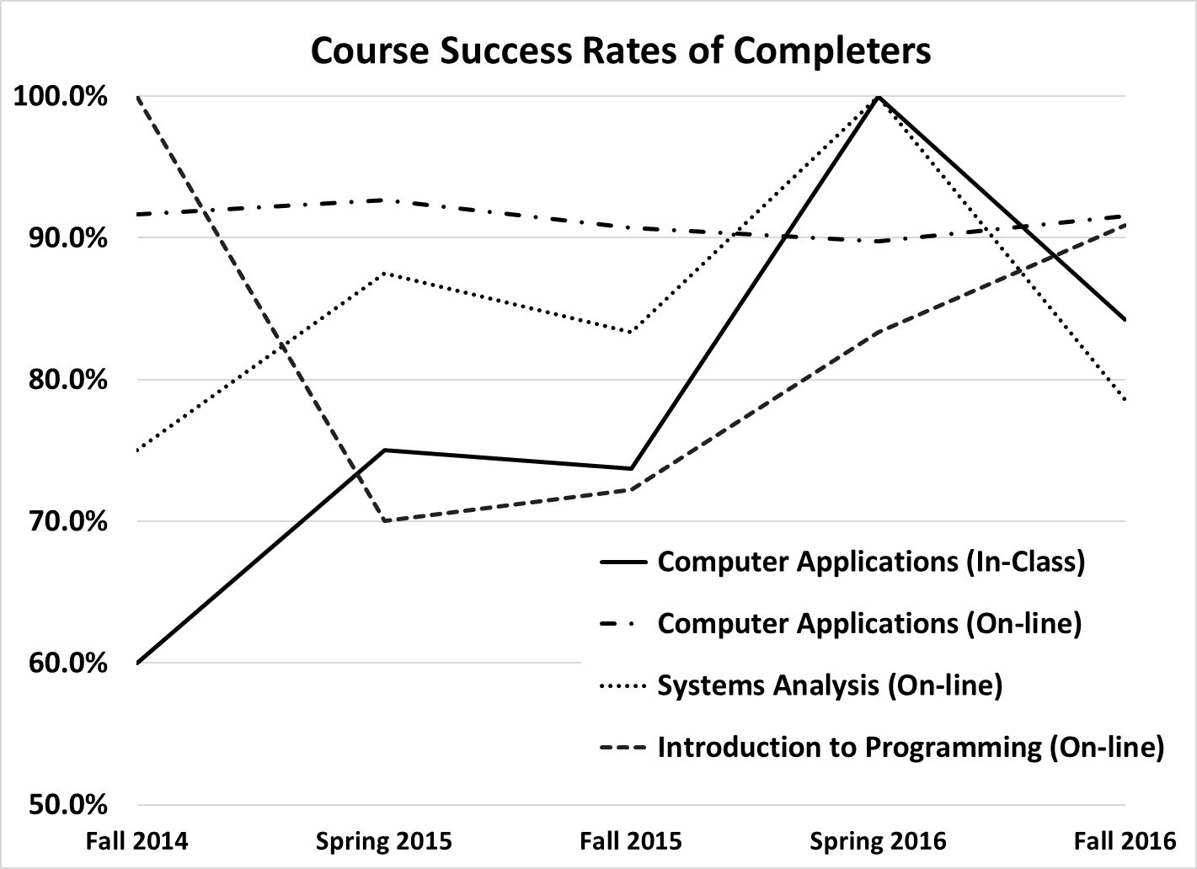

Slide 30
Other Findings
Retention rates for Computer Applications (In-class) increased by 11.4%--
much higher than the other three online courses.
Success rates for Computer Applications (In-class) increased by 24.2%--
much higher than the other three online courses.
Indication - the increased use of retention tools had a greater impact for the students taking courses
in-class.

Slide 31
Please send follow-up questions using text messaging
or to
Carmen.allen@llcc.edu
Thank you!

