Slide 1
Blurred Lines:
The Politics of Ethics in the Classroom
Ironda Joyce Campbell
Associate Professor
Pierpont Community & Technical College
Fairmont, WV 26554
League of Innovation – 2016 Innovations Conference
Chicago, Illinois

Slide 2
Blurred Lines:
The Politics of Ethics in the Classroom
Ironda Joyce Campbell
Associate Professor
Pierpont Community & Technical College
Fairmont, WV 26554
What is ethical is not always concrete or objective, but rather contextual—especially in creative, philosophical, and experiential learning. The concept of ethics within the learning environment versus established codes of ethics is discussed. Ironda J. Campbell

Slide 3
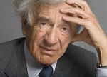
Elie Wiesel on Ethics Laureate, 1986 Nobel Prize for Peace
Ironda Joyce Campbell
Associate Professor
Pierpont Community & Technical College
Fairmont, WV 26554
Some 20 years ago my [wife] and I were thinking about new projects…of course we thought the theme of ethics must be predominant, whatever we do…too few people talk about it… they talk about the economy, sociology ...about politics… The question is where is ethics in all of this?...where is ethics? We don’t talk about ethics….
The Elie Wiesel Foundation Prize in Ethics: 20 years of ethical leadership (2016). Retrieved from
https://www.youtube.com/watch?v=Rr3jhs-pocQ

Slide 4
WORD ASSOCIATION
Ironda Joyce Campbell
Associate Professor
Pierpont Community & Technical College
Fairmont, WV 26554
I’ll say a word. Write the first word that comes to mind.
ONLY ONE WORD!

Slide 5
WORD ASSOCIATION
Ironda Joyce Campbell
Associate Professor
Pierpont Community & Technical College
Fairmont, WV 26554
ETHICS

Slide 6
WORD ASSOCIATION: ETHICS
Ironda Joyce Campbell
Associate Professor
Pierpont Community & Technical College
Fairmont, WV 26554
YOUR WORDS…

Slide 7
DEFINITION: ETHICS
Ironda Joyce Campbell
Associate Professor
Pierpont Community & Technical College
Fairmont, WV 26554
ethic
noun eth·ic \ˈe-thik\
rules of behavior based on ideas about what is morally good and bad
study that deals with ideas about what is good and bad behavior
a branch of philosophy dealing with what is morally right or wrong
discipline dealing with what is good/bad; moral duty and obligation
a set of moral principles
Ethic. (n). In Merriam-Webster’s online dictionary (2015). Retrieved from http://www.merriam-webster.com/dictionary/ethics

Slide 8
DEFINITION: CODE OF ETHICS
Ironda Joyce Campbell
Associate Professor
Pierpont Community & Technical College
Fairmont, WV 26554
Principles of conduct within an organization* that guide decision making and behavior. The code provides persons with guidelines for making ethical choices in the conduct of their work. Members* adopt a code of ethics to share a dedication to ethical behavior and to declare the organization's principles and standards of practice.
USLegal, Inc (2016). Code of ethics law and legal definition. Retrieved from http://definitions.uslegal.com/c/code-of-ethics/

Slide 9

QUESTION?????
Ironda Joyce Campbell
Associate Professor
Pierpont Community & Technical College
Fairmont, WV 26554
Is it plausible to have a legally enforced Code of Ethics for the whole of the United States of America?
YES NO

Slide 10
ANSWER
Ironda Joyce Campbell
Associate Professor
Pierpont Community & Technical College
Fairmont, WV 2655
NO
In America’s free and diverse society, people are able to disagree expressly about what they view to be morally good or bad. Ergo, outside of a ‘company policy’ people cannot be legally forced or obliged to acquiesce to what someone else believes is ‘good’ or ‘bad’, i.e. a code of ethics.

Slide 11
Blurred Lines:
The Politics of Ethics in the Classroom
Ironda Joyce Campbell
Associate Professor
Pierpont Community & Technical College
Fairmont, WV 26554
All communication is impacted by context and culture.
Ironda J. Campbell (2008, 2016)

Slide 12
Blurred Lines:
The Politics of Ethics in the Classroom
Ironda Joyce Campbell
Associate Professor
Pierpont Community & Technical College
Fairmont, WV 26554
Instructor faux pas(s)? Academic Freedom?
Proactive measures: Guiding Student in ethics exercises

Slide 13
Blurred Lines:
The Politics of Ethics in the Classroom
Ironda Joyce Campbell
Associate Professor
Pierpont Community & Technical College
Fairmont, WV 26554
Instructor
Academic Freedom???????

Slide 14
Blurred Lines:
The Politics of Ethics in the Classroom
Ironda Joyce Campbell
Associate Professor
Pierpont Community & Technical College
Fairmont, WV 26554
Instructor
Academic Freedom????

Slide 15
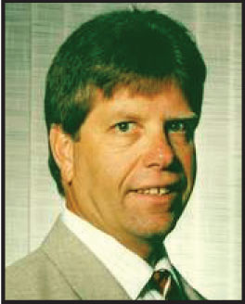
Blurred Lines:
The Politics of Ethics in the Classroom
Ironda Joyce Campbell
Associate Professor
Pierpont Community & Technical College
Fairmont, WV 26554
Professor Fired for Comments
Timothy Taylor, a UF professor of Food and Resource Economics, was fired for making sexually inappropriate and derogatory comments while teaching. Several of Taylor’s students said that during case studies on sexual harassment, professor Taylor allegedly “indicated that in some cultures women liked to show their sexuality, dress promiscuously, and wear very revealing clothes,” that according to an Investigation Findings report. Students also alleged that Taylor “looks female students up and down” and once asked a girl to dance to her cell phone ringtone after her phone rang during class. Taylor worked at UF since 1980, and witnesses in the report stated that he allegedly said in class that he is a full tenured professor, and he can do whatever he wants.
Dinkova, L. (September 22, 2010). Professor fired for comments. The Independent Florida Alligator. Retrieved
http://www.alligator.org/news/campus/article_089e896a-c604-11df-88e0-001cc4c03286.html

Slide 16
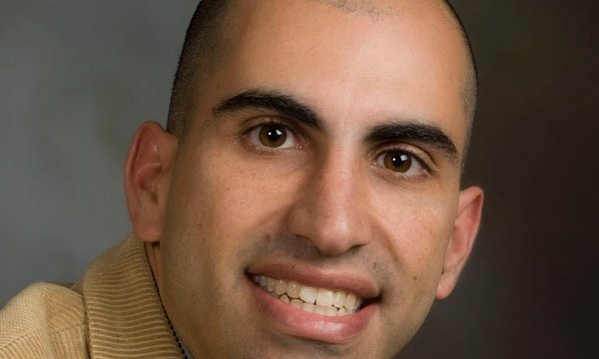
Blurred Lines:
The Politics of Ethics in the Classroom
Ironda Joyce Campbell
Associate Professor
Pierpont Community & Technical College
Fairmont, WV 26554
Professor Fired for Israel Criticism
Steven Salaita, accepted a faculty appointment at the University of Illinois in October 2013 to teach in the American Indian Studies program starting January 2014. His appointment was revoked in early August, after he posted to Twitter several messages criticizing Israel. Salaita, spoke publicly saying he should be reinstated on the grounds of academic freedom. “I am a passionate advocate for equality, a fair and open-minded instructor, and highly collegial. No legitimate evidence exists for any claims or insinuations to the contrary, which have severely damaged any reputation and my prospects for future employment,”. Salaita tweeted, “Only Israel can murder around 300 children in the span of a few weeks and insist that it is the victim,”. “If Netanyahu appeared on TV with a necklace made from the teeth of Palestinian children, would anybody be surprised,” he tweeted. University officials described his comments as uncivil, saying they represented “disrespectful and demeaning speech that promotes malice”. Since then, some academics have mounted a boycott of the university, saying it is not the institute’s place to dictate civil discourse. They also claim the university has become too beholden to wealthy donors who they say are informally dictating decisions involving hiring and tenure.
Guarino, M. (September 9, 2014). Professor fired for Israel criticism urges University of Illinois to reinstate him. Higher Education. Retrieved from http://www.theguardian.com/education/2014/sep/09/professor-israel-criticism-twitter-university-illinois

Slide 17
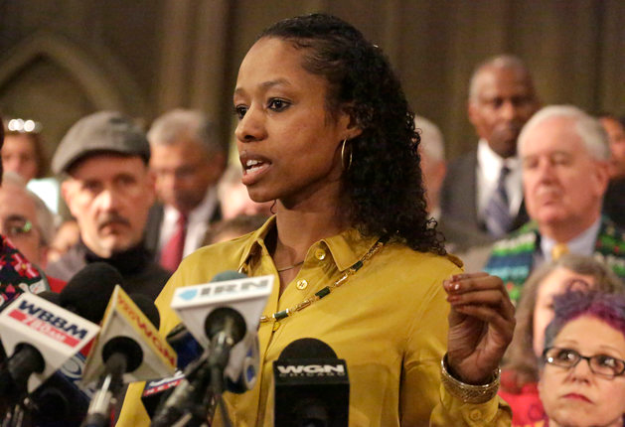
Blurred Lines:
The Politics of Ethics in the Classroom
Ironda Joyce Campbell
Associate Professor
Pierpont Community & Technical College
Fairmont, WV 26554
Professor Larycia Hawkins- To ‘Part Ways’ With College Over Comments About Islam Professor Hawkins said Christians and Muslims “worship the same God.” The college placed Hawkins on administrative leave as a result...subsequently the school’s provost recommended Hawkins be fired.
Huffington Post (February 8, 2016). Retrieved from www.huffingtonpost.com/entry/wheaton-college-professor-muslim-christian-same-god_us_56b8ead0e4b08069c7a8430d

Slide 18
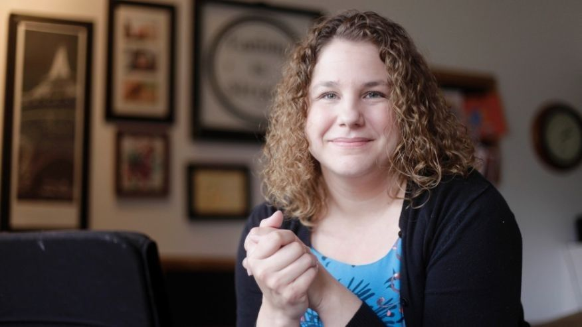
Blurred Lines:
The Politics of Ethics in the Classroom
Ironda Joyce Campbell
Associate Professor
Pierpont Community & Technical College
Fairmont, WV 26554
Assistant communication studies professor Andrea Quenette on paid leave since Nov. 12, when she used the “n-word” during a discussion about how to talk to undergraduate students on college campuses about sensitive racial issues. She will get to keep her job after using a racial slur in class last fall, upsetting a group of graduate students.
Washington Post (2016). Kansas professor who used racial slur in class is cleared of wrongdoing. Retrieved from https://www.washingtonpost.com/news/grade-point/wp/2016/03/20/kansas-professor-who-used-racial-slur-in-class-is-cleared-of-wrongdoing/

Slide 19
Guiding Students in ethics exercises
Ironda Joyce Campbell
Associate Professor
Pierpont Community & Technical College
Fairmont, WV 26554
Exercise: The GROUP DISCUSSION
Involves an applied learning construct
Encourages students to engage the concept of ‘ethics’
Causes students to identify current, contemporary examples of individuals and/or corporations involved in ethical or unethical behavior with a focus on integrity

Slide 20
Guiding Students in ethics exercises
Ironda Joyce Campbell
Associate Professor
Pierpont Community & Technical College
Fairmont, WV 26554
Using my model for The Group Discussion:
Students are placed in groups
Encouraged to find contemporary profiles of individuals or organizations that either engaged in good representations of integrity or infractions of integrity
They research the topic and the entity chosen
The students present information in a panel-style interactive discussion
Other students are audience members
The panelists field questions from their audience
The instructor regulates and guides the communication flow

Slide 21
Guiding Student in ethics exercises
Ironda Joyce Campbell
Associate Professor
Pierpont Community & Technical College
Fairmont, WV 26554
Group Discussion Instruction and Critique Sheet
Topical panel discussions will revolve around integrity.
Integrity: Self-regard and self-respect as well as positive regard and respect for others; well-being to self and others; assertive behavior versus aggressive behavior in business and in personal endeavors.
Assignment:
Choose a topic from current issues (from present up to two years ago) to analyze and discuss on either side of the integrity issue. The person, company, or activity can be a representation of what integrity is or a representation of what integrity is not.
I will select the groups, group members, captains and co-captains. The Group Discussion guidelines will assist you in building a topic, and the interactive group discussion.
The Group Discussion is an interactive discussion of a chosen topic led by a panel. The audience may interject at any time to comment or pose questions to the panel. The panel should comment and respond as ethically and best as possible, then continue with the discussion as outlined and constructed (by Group Discussion panel members).
Group Discussion Critique Sheet Group #_______________
Captain: ___________ Co-Captain: ___________ Names of [other] Group Members:
1. Typed Report (Overview of Topic) 1 page with typed sources [25 pts]
2. Visual aide [10 pts]
3. Oral Discussion/Presentation [60 pts total]
Was the report comprehensive? Was the point of the message understood? 10 pts
Was the presentation cohesive? Was there continuity in the flow of the information presented (versus being discombobulated)? Was the attitude of the group unified in the singular effort of engaging in the discussion and presenting the topical information? 10 pts
Did it appear that all participants had a clearly defined role? 30 pts
Did the group engage in additional efforts outside of the in-class group work to expound upon the topic for the presentation/discussion? 10 pts
4. Questions and Answers: Field topical questions from the audience. [5 pts]
Ironda J. Campbell, 2004©, 2015©, 20016©

Slide 22
Blurred Lines:
The Politics of Ethics in the Classroom
Ironda Joyce Campbell
Associate Professor
Pierpont Community & Technical College
Fairmont, WV 26554
Final Thoughts
What is ethical is not always concrete or objective, but rather contextual—especially in creative, philosophical, and experiential learning. The concept of ethics within the learning environment versus established codes of ethics is discussed.
All communication is impacted by context and culture.
As leaders, instructors, administrators, we have to keep in mind that all persons do not receive our communications favorably. Also, they may not process or receive the information as we intended, in spite of due diligence. As a result, they could deem the communication to be unethical, and academic freedom may not shield us.

